Slide 1
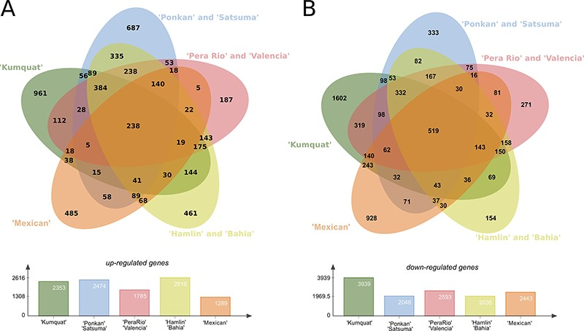
Figure 4. Differentially expressed genes (DEGs) present in the eight citrus genotypes considering the three analysed ...
Notes:
Figure 4. Differentially expressed genes (DEGs) present in the eight citrus genotypes considering the three analysed time stages (24, 48 and 72 h) post X. citri inoculation. (A) Upper panel, Venn diagram with the Up-regulated transcripts; Lower panel, total number of DEGs for each analysed genotype group. (B) Upper panel, venn diagram with the Down-regulated transcripts; Lower panel, total number of DEGs for each analysed genotype group.
Unless provided in the caption above, the following copyright applies to the content of this slide: © The Author(s) 2020. Published by Oxford University Press.This is an Open Access article distributed under the terms of the Creative Commons Attribution License (http://creativecommons.org/licenses/by/4.0/), which permits unrestricted reuse, distribution, and reproduction in any medium, provided the original work is properly cited.

