Slide 1
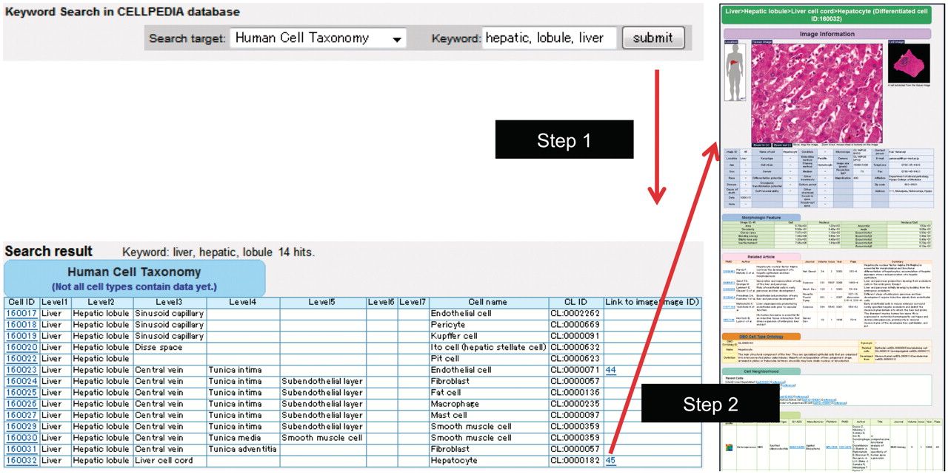
Figure 1. Example of keyword search and integrated page of hepatocyte (differentiated cell ID: 160032). (a) Retrieval ...
Notes:
Figure 1. Example of keyword search and integrated page of hepatocyte (differentiated cell ID: 160032). (a) Retrieval of cell taxonomy entries by keyword search (keywords: hepatic, lobule, liver) is shown (Step 1). Clicking on an image ID in the cell taxonomy page will lead to the integrated page (Step 2). The integrated page is composed of three types of primary data: (b) digital images of cells (and tissues); (c) gene expression data; and (d) journal articles. Additional secondary information is also provided, including (b) image parameters regarding cell shape (table of morphologic features); (e) the OBO Cell Type Ontology; and (f) cell differentiation neighborhood links.
Unless provided in the caption above, the following copyright applies to the content of this slide: © The Author(s) 2011. Published by Oxford University Press.This is Open Access article distributed under the terms of the Creative Commons Attribution Non-Commercial License (http://creativecommons.org/licenses/by-nc/2.5), which permits unrestricted non-commercial use, distribution, and reproduction in any medium, provided the original work is properly cited.

