Slide 1
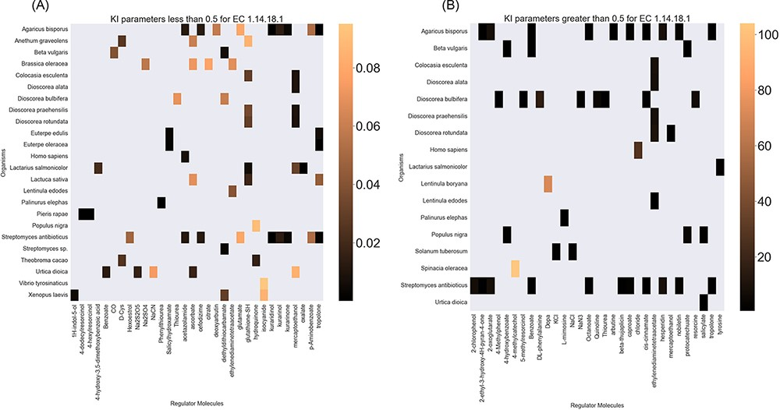
Figure 6. A heatmap of EC 1.14.18.1 ${{\rm{K}}_{\rm{I}}}$ values of regulator molecules (x-axis) seen in particular ...
Notes:
Figure 6. A heatmap of EC 1.14.18.1 ${{\rm{K}}_{\rm{I}}}$ values of regulator molecules (x-axis) seen in particular organisms (y-axis). As the distribution of ${{\rm{K}}_{\rm{I}}}$ is highly skewed, data is visualized in two heatmaps (the first heatmap presents a heatmap of values less than 0.5 and the second figure represents a heatmap of parameters greater than 0.5). Lower values of ${{\rm{K}}_{\rm{I}}}$ parameters are associated with higher inhibition effects.
Unless provided in the caption above, the following copyright applies to the content of this slide: © The Author(s) 2022. Published by Oxford University Press.This is an Open Access article distributed under the terms of the Creative Commons Attribution-NonCommercial License (https://creativecommons.org/licenses/by-nc/4.0/), which permits non-commercial re-use, distribution, and reproduction in any medium, provided the original work is properly cited. For commercial re-use, please contact journals.permissions@oup.com

