Slide 1
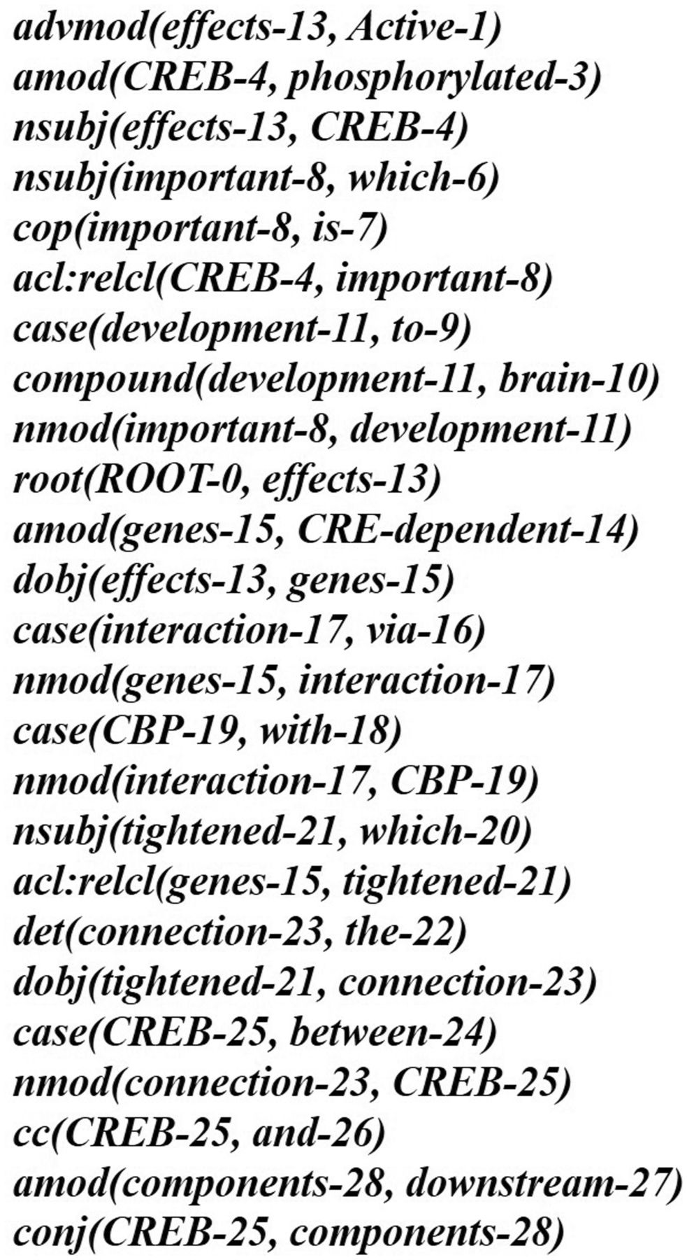
Figure 9. The typed dependencies representation of the example sentence. The dependency graph of the example ...
Notes:
Figure 9. The typed dependencies representation of the example sentence. The dependency graph of the example sentence. Figure 11.The pruning operation of IPT of the example sentence. Stop word removal: Frequent words are not useful for expressing interactions between proteins. For instance, the word ‘with’ in Figure 8 is a common preposition and cannot be utilized to discriminate interactive expressions. To remove stop words and the corresponding syntactic elements from the IPT, we sort words according to their frequency in the text corpus, and the most frequent words are used to compile a stop word list. More specifically, we selected the most frequent words whose accumulated frequencies reached 80% of the total word frequency count in the five corpora, since the rank-frequency distribution of words follows Zip’s law (26). Protein names and verbs are excluded from the list for refinement, since both are key constructs of protein-protein interactions. Duplicate element removal: Nodes in an IPT would be duplicated and therefore are redundant. A node is duplicated if it has a single child and its tag is also identical to that of its parent. For instance, the node VP in the last branch of Figure 8 is a duplicate node. Since the tree kernel we adopted to compute the similarity between text sentences is based on the percentage of overlap between IPTs, duplicate nodes would degrade our system performance. To reduce their influence, the pruning operator deletes all duplicate nodes in an IPT. As shown in Figure 11, the pruned IPT is more concise and clearer than its original.
Unless provided in the caption above, the following copyright applies to the content of this slide: © The Author(s) 2016. Published by Oxford University Press.This is an Open Access article distributed under the terms of the Creative Commons Attribution License (http://creativecommons.org/licenses/by/4.0/), which permits unrestricted reuse, distribution, and reproduction in any medium, provided the original work is properly cited.

