Slide 1
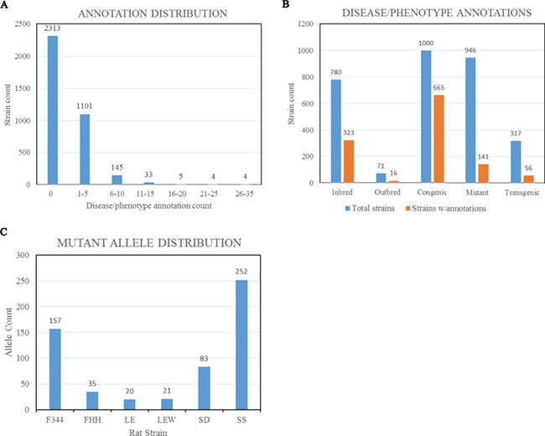
Figure 3 (A) Disease/phenotype distribution among rat strains at RGD. There are total 3605 registered strains shown in ...
Notes:
Figure 3 (A) Disease/phenotype distribution among rat strains at RGD. There are total 3605 registered strains shown in the bar chart. Close to 35% of the strains are annotated with one or more disease/phenotype terms. (B) Bar chart comparing the numbers of rat strains with disease/phenotype annotations across the selected five strain categories. (C) Rat strains carrying mutant alleles are grouped by background strains. Strain groups carrying at least 20 alleles are presented. F344, Fischer 344; FHH, Fawn Hooded Hypertensive; LE, Long Evans; LEW, Lewis; SD, Sprague–Dawley; SS, salt-sensitive Sprague–Dawley.
Unless provided in the caption above, the following copyright applies to the content of this slide: © The Author(s) 2019. Published by Oxford University Press.This is an Open Access article distributed under the terms of the Creative Commons Attribution License (http://creativecommons.org/licenses/by/4.0/), which permits unrestricted reuse, distribution, and reproduction in any medium, provided the original work is properly cited.

