Slide 1
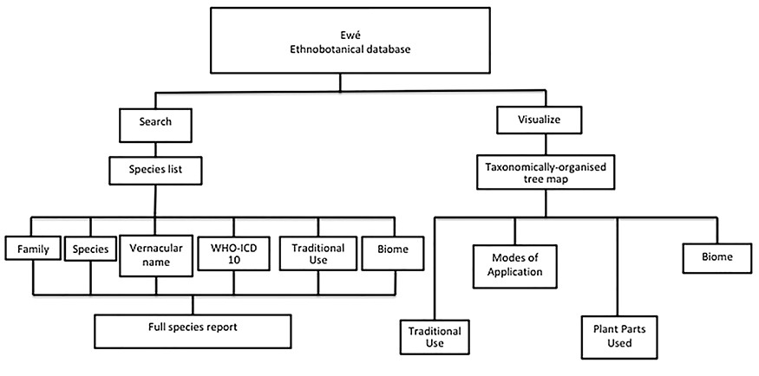
Figure 1 Organization of the Ewé database. The Ewé database has two functions: the search function and the visualize ...
Notes:
Figure 1 Organization of the Ewé database. The Ewé database has two functions: the search function and the visualize function. The search function queries a species list. Results can be organized according to any of the content elements (categories) or a full use report can be generated, including information on plant parts used, modes of application and the reference/source for that report. The visualize query provides visual information for sets of ethnomedicinally used species according to taxonomic rank (family, genus or species), including interactive histograms of traditional use, modes of application, plant parts used and biomes.
Unless provided in the caption above, the following copyright applies to the content of this slide: © The Author(s) 2020. Published by Oxford University Press.This is an Open Access article distributed under the terms of the Creative Commons Attribution License (http://creativecommons.org/licenses/by/4.0/), which permits unrestricted reuse, distribution, and reproduction in any medium, provided the original work is properly cited.

