Slide 1
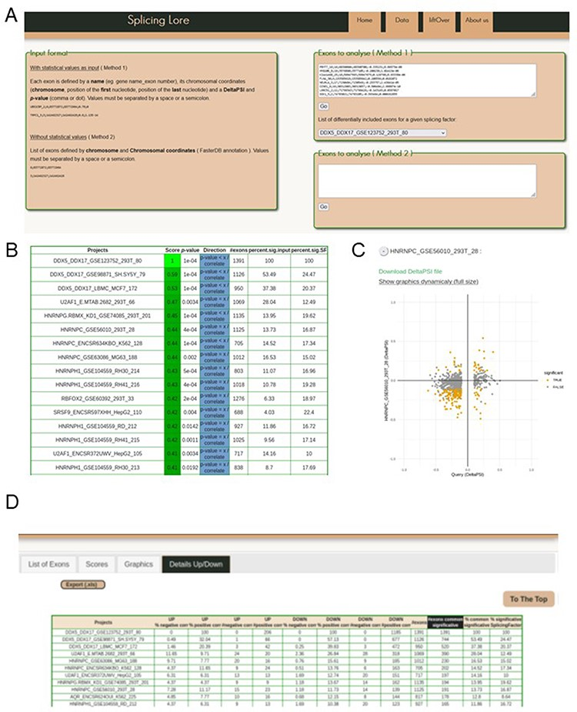
Figure 3. Visualization of the SplicingLore web interface. (A) View of the home page, with the instructions to prepare ...
Notes:
Figure 3. Visualization of the SplicingLore web interface. (A) View of the home page, with the instructions to prepare the input list of exons and the query window. This includes the drop-down menu that allows to retrieve a given list of SF-regulated exons from the database. (B) View of the top of the main output file, showing for each dataset the different correlation parameters with the query list (here the exons regulated by DDX5/DDX17 in 293T cells). The Score and associated P-value for positive or negative correlation are provided for each dataset of the database, along with the total number of exons in the corresponding dataset and the fraction of common exons between the compared datasets, relative to the query list or to the tested dataset. (C) The correlation graph of the ∆PSI values for common exons from the query list and one of the stored datasets. Coloured dots represent exons that are significantly regulated by both SF. The file containing the corresponding ∆PSI values for these exons can be downloaded here. (D) View of the top of the detailed output file, which provides the number (#) and fraction (%) of shared exons between the query and the dataset, separated in up-regulated and down-regulated subclasses of exons. Alt text for Figure 3: Screenshots of the SplicingLore web interface and output files.
Unless provided in the caption above, the following copyright applies to the content of this slide: © The Author(s) 2023. Published by Oxford University Press.This is an Open Access article distributed under the terms of the Creative Commons Attribution License (https://creativecommons.org/licenses/by/4.0/), which permits unrestricted reuse, distribution, and reproduction in any medium, provided the original work is properly cited.

