Slide 1
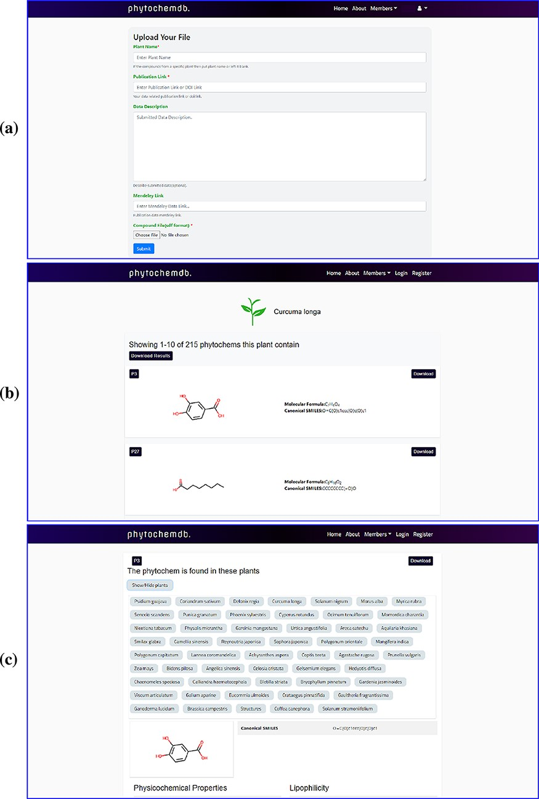
Figure 2. Web-interface of the ‘phytochemdb’ database. (a) Webpage for contribution to the database. (b) Webpage with ...
Notes:
Figure 2. Web-interface of the ‘phytochemdb’ database. (a) Webpage for contribution to the database. (b) Webpage with all available compounds for a specific plant. (c) Webpage with relative availability of a compound in distinct plants.
Unless provided in the caption above, the following copyright applies to the content of this slide: © The Author(s) 2022. Published by Oxford University Press.This is an Open Access article distributed under the terms of the Creative Commons Attribution License (https://creativecommons.org/licenses/by/4.0/), which permits unrestricted reuse, distribution, and reproduction in any medium, provided the original work is properly cited.

