Slide 1
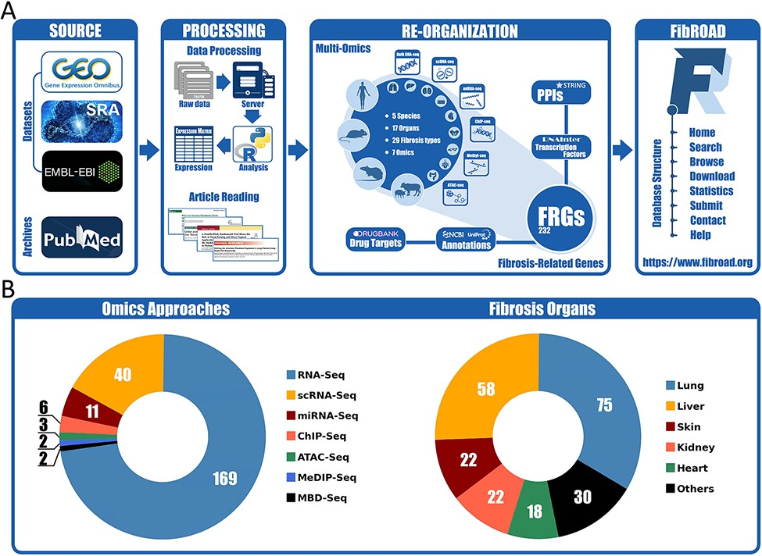
Figure 1. Workflow and statistics for the FibROAD database. (A) pipeline diagram depicting construction of the ...
Notes:
Figure 1. Workflow and statistics for the FibROAD database. (A) pipeline diagram depicting construction of the principal workflow of FibROAD. (B) Pie diagrams for the proportions of omic approaches (left) and organs (right) collected in FibROAD, with numbers indicating totals of projects.
Unless provided in the caption above, the following copyright applies to the content of this slide: © The Author(s) 2022. Published by Oxford University Press.This is an Open Access article distributed under the terms of the Creative Commons Attribution License (https://creativecommons.org/licenses/by/4.0/), which permits unrestricted reuse, distribution, and reproduction in any medium, provided the original work is properly cited.

