Slide 1
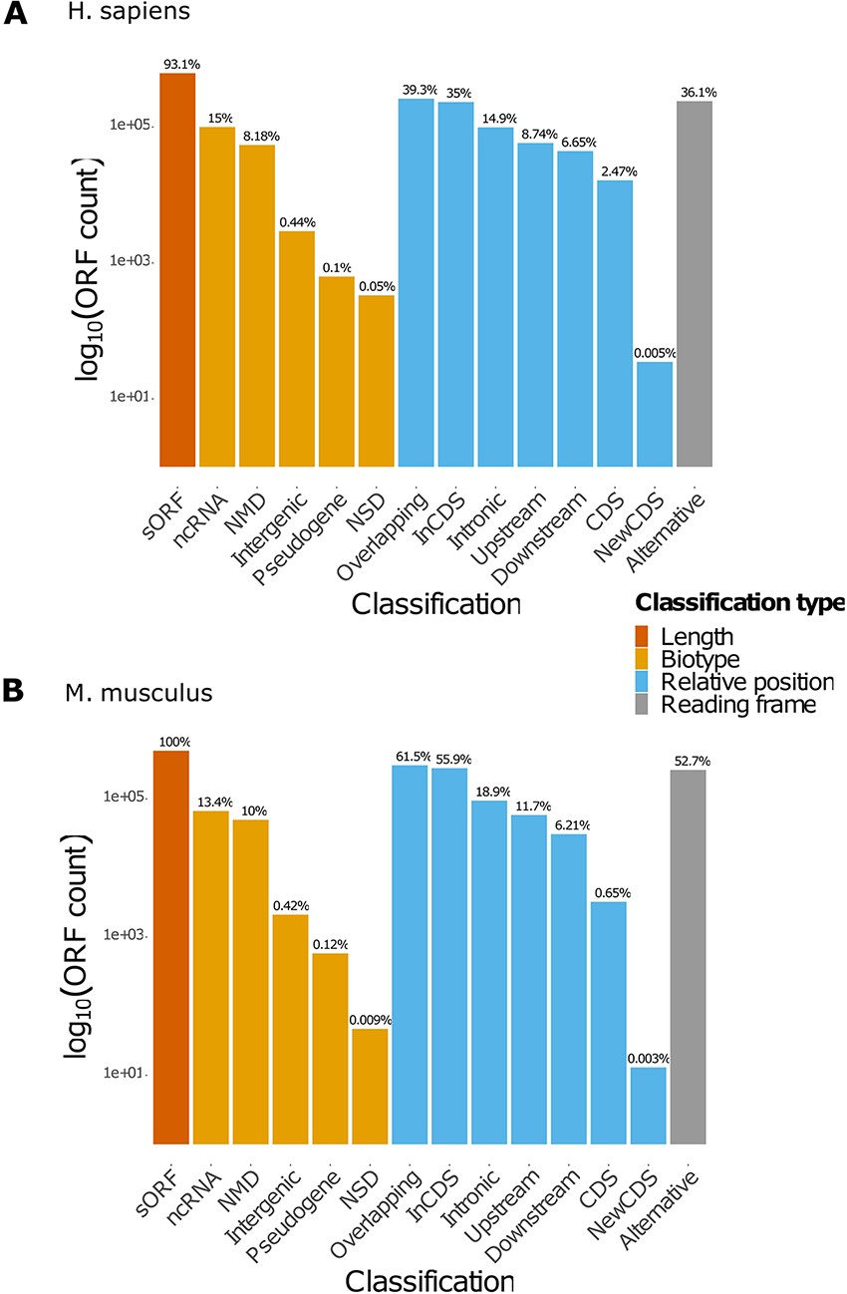
Figure 2. Count of ORFs in each class. The bar plots represent the count of ORFs annotated for each class for (A) H. ...
Notes:
Figure 2. Count of ORFs in each class. The bar plots represent the count of ORFs annotated for each class for (A) H. sapiens and (B) M. musculus. The percentages displayed over the bars indicate the proportion of ORFs annotated in the class over the total number of ORFs registered in the database for the species. NMD: non-sense-mediated decay; NSD: non-stop decay.
Unless provided in the caption above, the following copyright applies to the content of this slide: © The Author(s) 2021. Published by Oxford University Press.This is an Open Access article distributed under the terms of the Creative Commons Attribution License (http://creativecommons.org/licenses/by/4.0/), which permits unrestricted reuse, distribution, and reproduction in any medium, provided the original work is properly cited.

