Slide 1
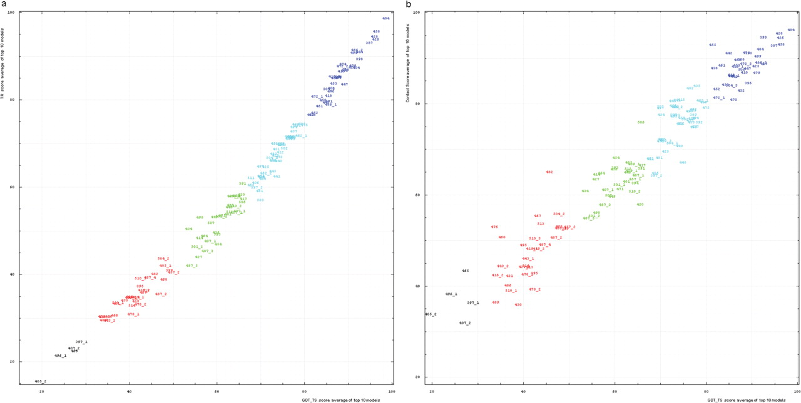
Figure 5. (a) Correlation between TR score (vertical axis) and GDT-TS (horizontal axis). (b) Correlation between ...
Notes:
Figure 5. (a) Correlation between TR score (vertical axis) and GDT-TS (horizontal axis). (b) Correlation between contact score CS (vertical axis) and GDT-TS (horizontal axis). Scores for top 10 first server models were averaged for each domain shown by its number positioned at a point with the coordinates equal to these averaged scores. Domain numbers are colored according to the difficulty category suggested by our analysis: black, FM (free modeling); red, FR (fold recognition); green, CM_H (comparative modeling: hard); cyan, CM_M (comparative modeling: medium); blue, CM_E (comparative modeling: easy).
Unless provided in the caption above, the following copyright applies to the content of this slide: © 2009 The Author(s).This is Open Access article distributed under the terms of the Creative Commons Attribution Non-Commercial License (http://creativecommons.org/licenses/by-nc/2.0/uk/) which permits unrestricted non-commercial use, distribution, and reproduction in any medium, provided the original work is properly cited.

