Slide 1
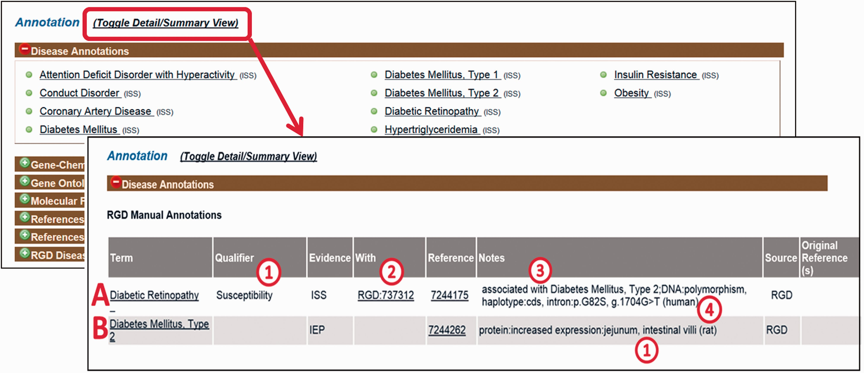
Figure 2. Disease annotation display examples. Shown fields are term, qualifier (A1), evidence code, “With” field (A2), ...
Notes:
Figure 2. Disease annotation display examples. Shown fields are term, qualifier (A1), evidence code, “With” field (A2), reference, “Notes” field composed of background disease field (A3), alteration level field, modifier field, location field (two entries, B1), free text field (A4).
Unless provided in the caption above, the following copyright applies to the content of this slide: © The Author(s) 2016. Published by Oxford University Press. This is an Open Access article distributed under the terms of the Creative Commons Attribution License ( http://creativecommons.org/licenses/by/4.0/ ), which permits unrestricted reuse, distribution, and reproduction in any medium, provided the original work is properly cited.

