Slide 1
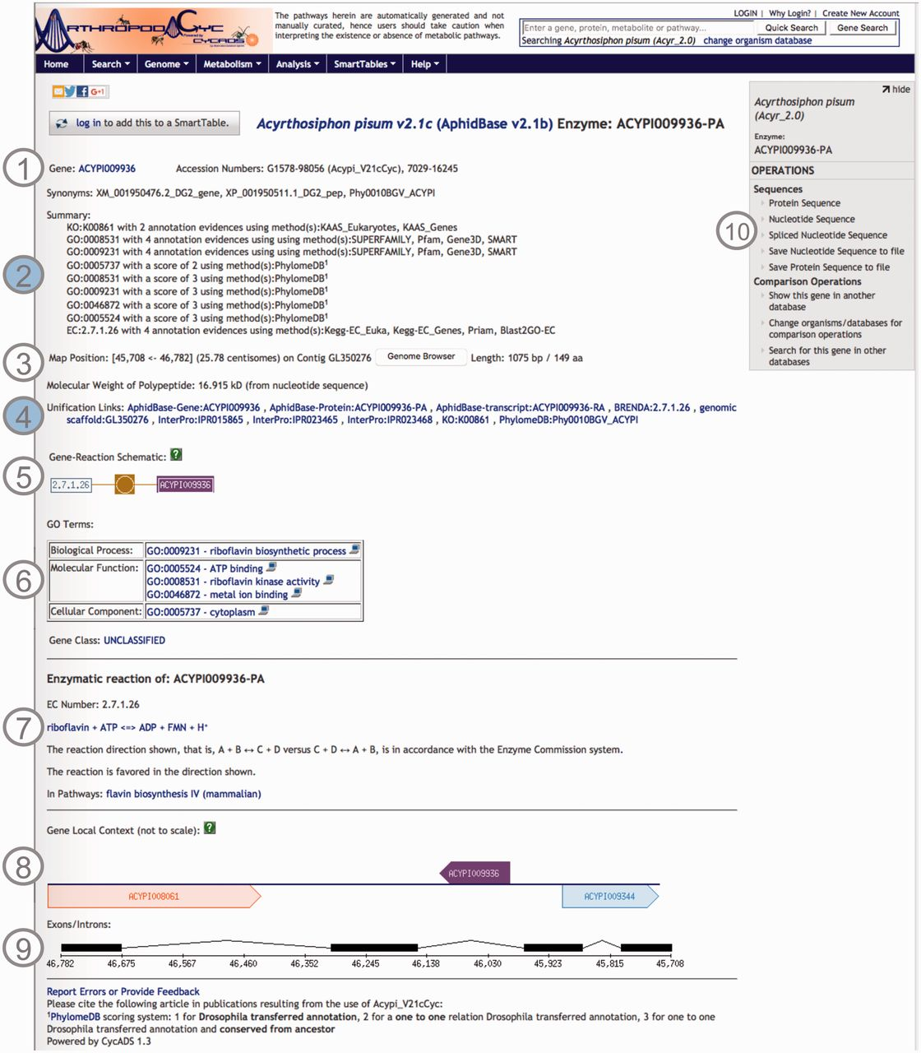
Figure 2. Screenshot of an ArthropodaCyc enzyme page. The page provides several information such as: (1) gene name, ...
Notes:
Figure 2. Screenshot of an ArthropodaCyc enzyme page. The page provides several information such as: (1) gene name, accession numbers and synonym names; (2) a summary of metabolism annotation evidences from KAAS-KEGG, PRIAM, InterProScan, PhylomeDB and BLAST2GO; (3) genome position with an additional link to the corresponding genome browser, and information on gene and protein length and polypeptide molecular weight; (4) external cross-links to specific genomic databases, enzyme annotation and InterProScan domains information and to phylogeny in PhylomeDB; (5) schematics representing the reaction(s) carried out by the enzyme; (6) Gene ontology terms associated with the enzyme functions; (7) additional information on the reaction(s) carried out by the enzyme, including the pathway(s) (if any) where this reaction may occur; (8) gene local context, including neighbouring genes; (9) gene structure in terms of (added) exons/introns organization and (10) an “Operations box” offering several options for comparative analyses. Filled circles, (2) and (4), represent ArthropodaCyc specific features.
Unless provided in the caption above, the following copyright applies to the content of this slide: © The Author(s) 2016. Published by Oxford University Press.This is an Open Access article distributed under the terms of the Creative Commons Attribution License (http://creativecommons.org/licenses/by/4.0/), which permits unrestricted reuse, distribution, and reproduction in any medium, provided the original work is properly cited.

