Slide 1
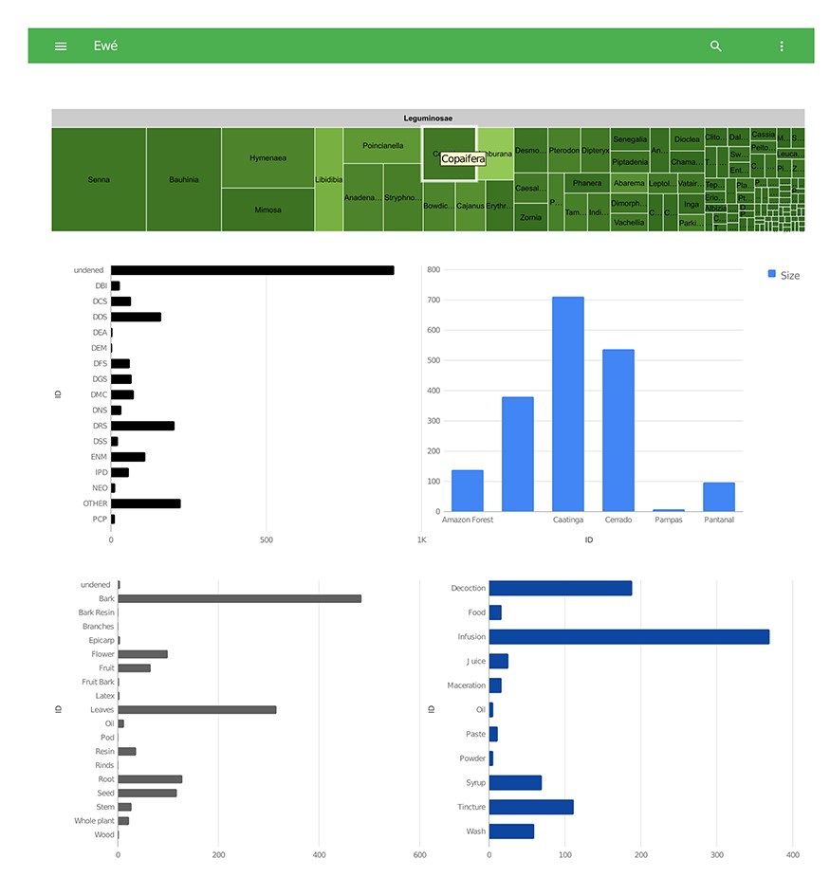
Figure 4 Detail of the visualization tool from Ewé showing graphs with therapeutic applications, biomes, plant parts ...
Notes:
Figure 4 Detail of the visualization tool from Ewé showing graphs with therapeutic applications, biomes, plant parts used and modes of applications.
Unless provided in the caption above, the following copyright applies to the content of this slide: © The Author(s) 2020. Published by Oxford University Press.This is an Open Access article distributed under the terms of the Creative Commons Attribution License (http://creativecommons.org/licenses/by/4.0/), which permits unrestricted reuse, distribution, and reproduction in any medium, provided the original work is properly cited.

Slide 2
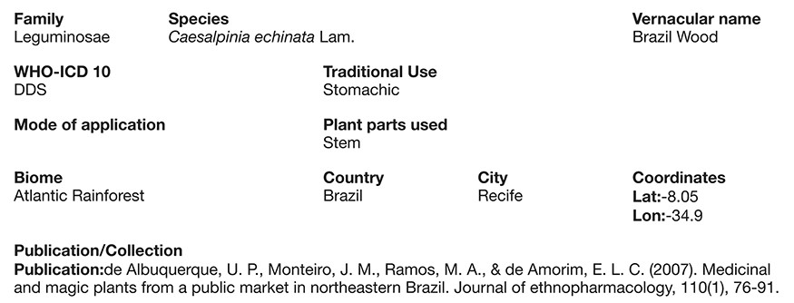
Figure 3 Screen shot of a full record (Caesalpinia echinata Lam.) illustrating its described uses, the part used, ...
Notes:
Figure 3 Screen shot of a full record (Caesalpinia echinata Lam.) illustrating its described uses, the part used, traditional use, forms of use (modes of application) and the paper reference from where it came from.
Unless provided in the caption above, the following copyright applies to the content of this slide: © The Author(s) 2020. Published by Oxford University Press.This is an Open Access article distributed under the terms of the Creative Commons Attribution License (http://creativecommons.org/licenses/by/4.0/), which permits unrestricted reuse, distribution, and reproduction in any medium, provided the original work is properly cited.

Slide 3
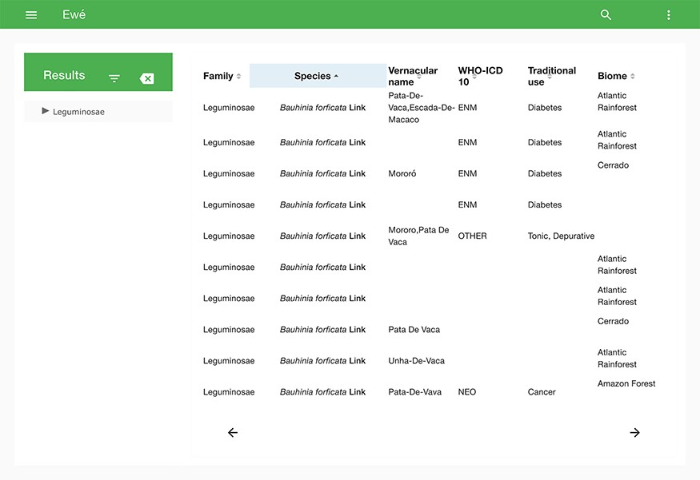
Figure 2 Search tool of Ewé, showing the number of records and data contents of each field of a chosen sample.
Notes:
Figure 2 Search tool of Ewé, showing the number of records and data contents of each field of a chosen sample.
Unless provided in the caption above, the following copyright applies to the content of this slide: © The Author(s) 2020. Published by Oxford University Press.This is an Open Access article distributed under the terms of the Creative Commons Attribution License (http://creativecommons.org/licenses/by/4.0/), which permits unrestricted reuse, distribution, and reproduction in any medium, provided the original work is properly cited.

Slide 4
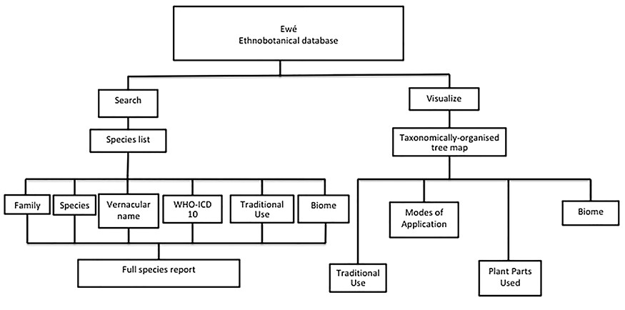
Figure 1 Organization of the Ewé database. The Ewé database has two functions: the search function and the visualize ...
Notes:
Figure 1 Organization of the Ewé database. The Ewé database has two functions: the search function and the visualize function. The search function queries a species list. Results can be organized according to any of the content elements (categories) or a full use report can be generated, including information on plant parts used, modes of application and the reference/source for that report. The visualize query provides visual information for sets of ethnomedicinally used species according to taxonomic rank (family, genus or species), including interactive histograms of traditional use, modes of application, plant parts used and biomes.
Unless provided in the caption above, the following copyright applies to the content of this slide: © The Author(s) 2020. Published by Oxford University Press.This is an Open Access article distributed under the terms of the Creative Commons Attribution License (http://creativecommons.org/licenses/by/4.0/), which permits unrestricted reuse, distribution, and reproduction in any medium, provided the original work is properly cited.

