Slide 1
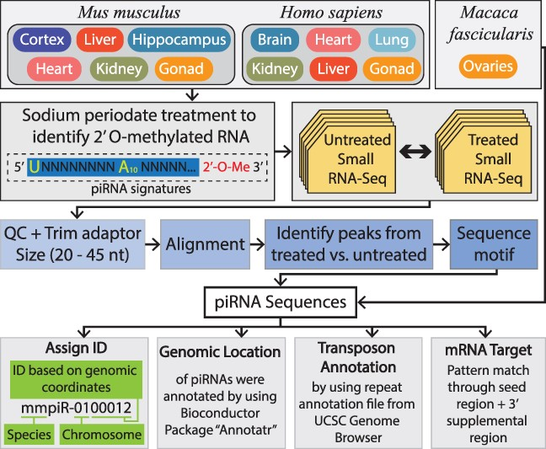
Figure 1. The top panel indicates the tissues from M. musculus, M. fascicularis and H. sapiens included within piOxi DB ...
Notes:
Figure 1. The top panel indicates the tissues from M. musculus, M. fascicularis and H. sapiens included within piOxi DB that were subjected to sodium periodate treatment. The second panel demonstrates that small RNA sequencing of the M. musculus and H. sapiens tissues was analyzed by comparing periodate-treated versus untreated samples. The third panel specifies how the data were processed using adapter trimming, alignment to the respective genome, identification of piRNA peaks between treated and untreated samples and determination of piRNA sequence motifs. The fourth panel designates the criteria used for piRNA identification assignment used for sequences and for genomic location, transposon annotation and mRNA targets used for annotations. Alt text: Flowchart overview of the piOxi DB.
Unless provided in the caption above, the following copyright applies to the content of this slide: © The Author(s) 2024. Published by Oxford University Press.This is an Open Access article distributed under the terms of the Creative Commons Attribution License (https://creativecommons.org/licenses/by/4.0/), which permits unrestricted reuse, distribution, and reproduction in any medium, provided the original work is properly cited.

Slide 2
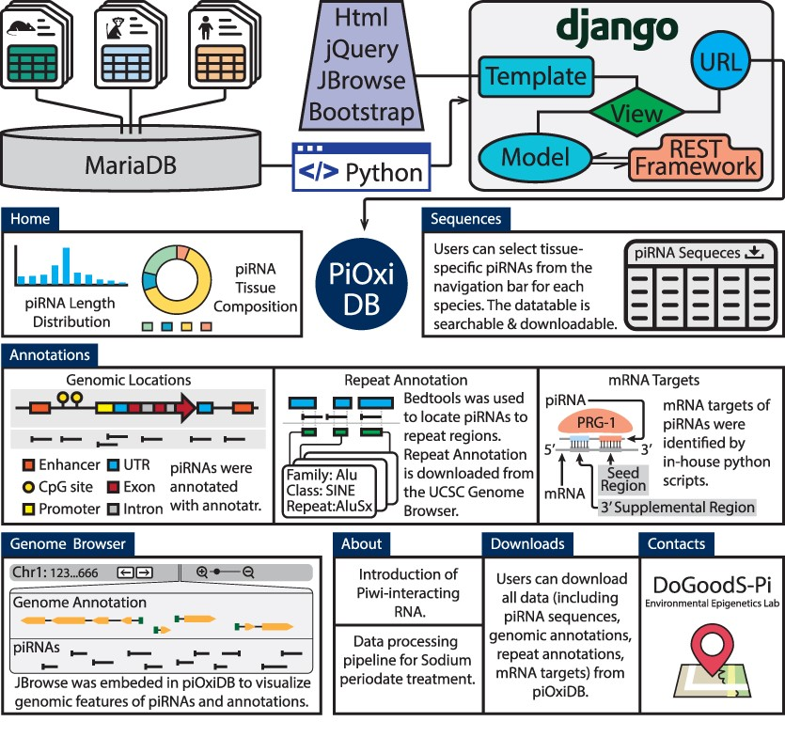
Figure 2. The piOxi DB website includes mouse, macaque and human piRNA data. Data were stored in MariaDB. Django with ...
Notes:
Figure 2. The piOxi DB website includes mouse, macaque and human piRNA data. Data were stored in MariaDB. Django with the REST framework was used to establish the webserver. JQuery, JBrowse and Bootstrap were used in implementing the frontend. The ‘Homepage’ includes a brief introduction and species-specific summary, including piRNA length distributions (histogram) and tissue compositions (pie chart). A representative table is included within the ‘Sequences’ that contains tissue-specific piRNA data for each species. The ‘Annotations’ tables indicate specific genomic locations, repeats and potential mRNA targets for the piRNA sequences found within piOxi DB. The ‘Browser’ function of piOxi DB allows the users to visualize the piRNA sequences of piOxi DB, relative to their corresponding genomic annotations. The ‘About’ section provides a brief introduction about piRNA, followed by ‘Downloads’ for data extrapolation and ‘Contacts’. Alt text: User-friendly features and utilities incorporated within piOxi DB.
Unless provided in the caption above, the following copyright applies to the content of this slide: © The Author(s) 2024. Published by Oxford University Press.This is an Open Access article distributed under the terms of the Creative Commons Attribution License (https://creativecommons.org/licenses/by/4.0/), which permits unrestricted reuse, distribution, and reproduction in any medium, provided the original work is properly cited.

