Slide 1
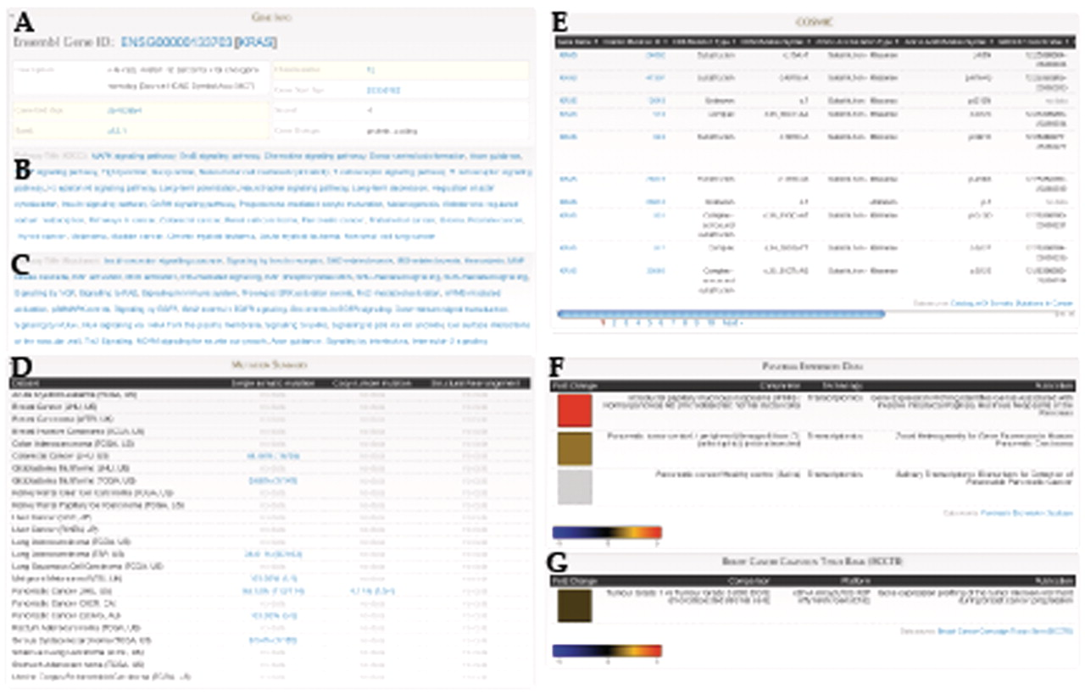
Figure 4. Gene Report for KRAS includes: (A) Gene annotation data from Ensembl, Pathway annotation from (B) KEGG and ...
Notes:
Figure 4. Gene Report for KRAS includes: (A) Gene annotation data from Ensembl, Pathway annotation from (B) KEGG and (C) Reactome, (D) Summary of mutation frequencies in each cancer project, (E) Mutation data from COSMIC, Expression data from (F) Pancreatic Expression Database and (G) Breast Cancer Campaign Tissue Bank (BCCTB). Different sections of this page come from federated BioMart sources.
Unless provided in the caption above, the following copyright applies to the content of this slide: © The Author(s) 2011. Published by Oxford University Press.This is Open Access article distributed under the terms of the Creative Commons Attribution Non-Commercial License (http://creativecommons.org/licenses/by-nc/2.5), which permits unrestricted non-commercial use, distribution, and reproduction in any medium, provided the original work is properly cited.

