Slide 1
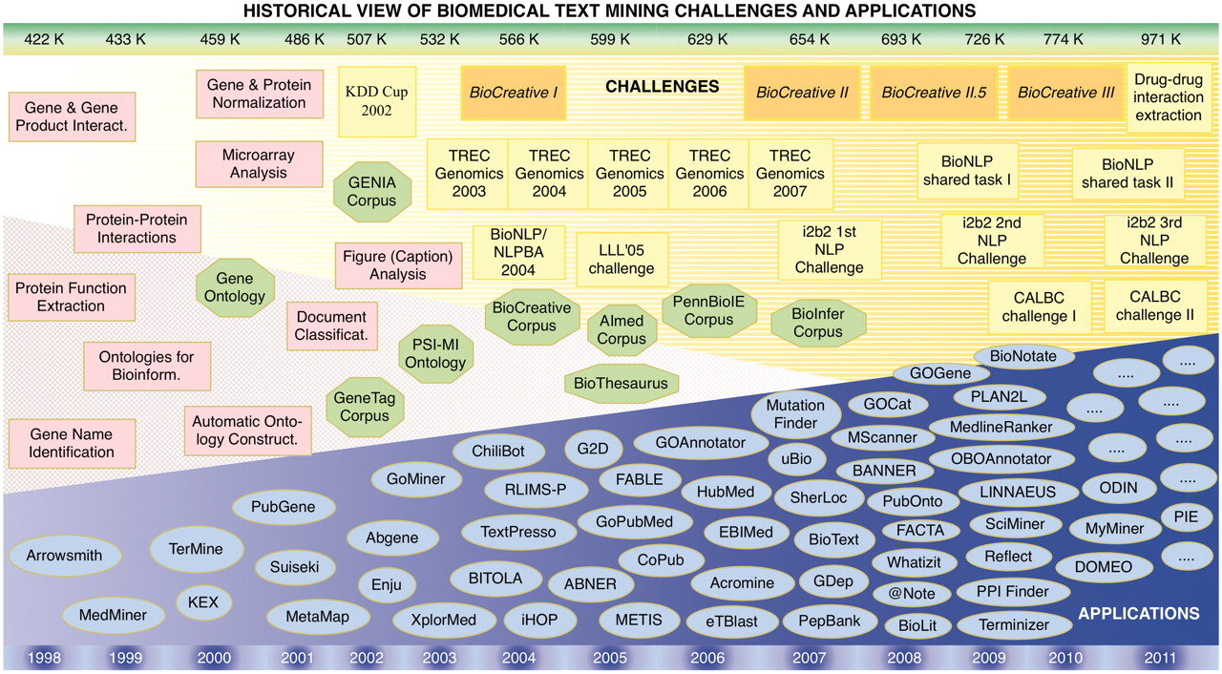
Figure 2. Historical view and timeline of the BioCreative challenges in the context of other community efforts, textual ...
Notes:
Figure 2. Historical view and timeline of the BioCreative challenges in the context of other community efforts, textual resources (corpora) and applications developed in the area of biomedical text mining. The upper bar shows the number of new records added to PubMed each year, expressed in thousands (K). The lower bar refers to the corresponding year timeline. Pink squares, appearance of biomedical text mining methods; green octagons, relevant ontologies, lexical resources and corpora; yellow boxes, community challenges; blue ovals, biomedical text mining applications.
Unless provided in the caption above, the following copyright applies to the content of this slide: © The Author(s) 2012. Published by Oxford University Press.This is an Open Access article distributed under the terms of the Creative Commons Attribution Non-Commercial License (http://creativecommons.org/licenses/by-nc/3.0), which permits unrestricted non-commercial use, distribution, and reproduction in any medium, provided the original work is properly cited.

