Slide 1
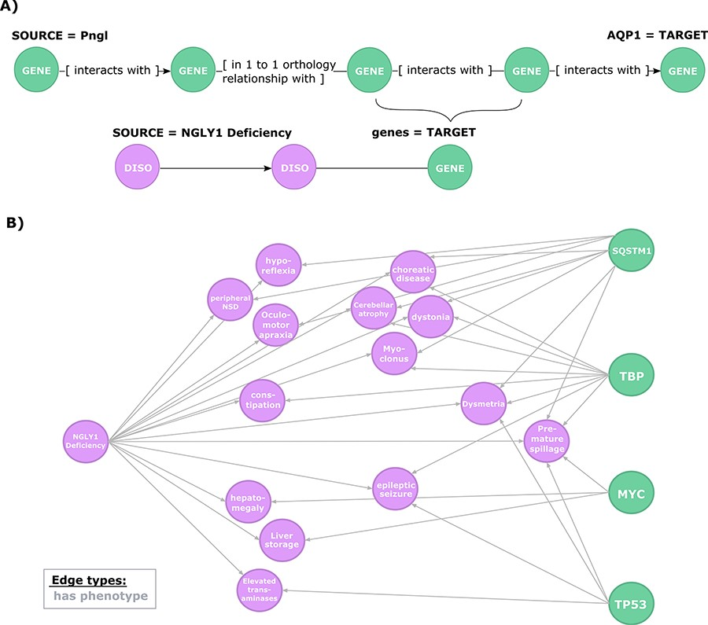
Figure 4 Exploration of the evidence relating candidate regulators of AQP1 to NGLY1 Deficiency phenotypes. (A) Second ...
Notes:
Figure 4 Exploration of the evidence relating candidate regulators of AQP1 to NGLY1 Deficiency phenotypes. (A) Second query topology for the AQP1 regulation-disease phenotypes shared genetic basis hypothesis. (B) Hypotheses resulted from the second query. All edges are of type ‘has phenotype’.
Unless provided in the caption above, the following copyright applies to the content of this slide: © The Author(s) 2020. Published by Oxford University Press.This is an Open Access article distributed under the terms of the Creative Commons Attribution License (http://creativecommons.org/licenses/by/4.0/), which permits unrestricted reuse, distribution, and reproduction in any medium, provided the original work is properly cited.

