Slide 1
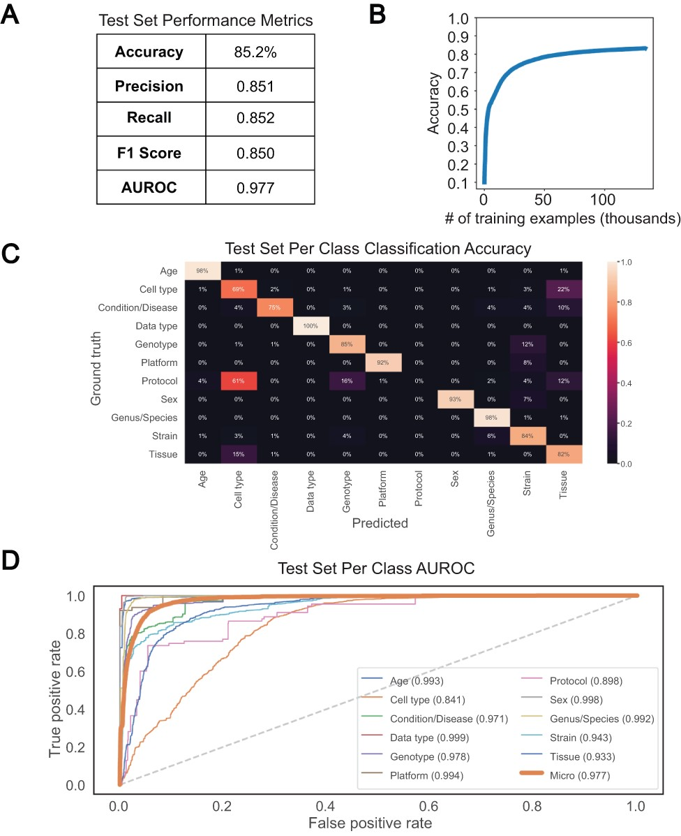
Figure 4. Performance of bi-LSTM in metadata category classification. (A) Accuracy, precision, recall, F1 score, and ...
Notes:
Figure 4. Performance of bi-LSTM in metadata category classification. (A) Accuracy, precision, recall, F1 score, and average AUROC calculated for all categories combined on held-out test set. (B) Accuracy of model classification on training set (y-axis) plotted against the number of training examples input (in thousands). (C) Percentage of each category correctly classified on held-out test set, shown as a heatmap, with predicted values on the x-axis and ground truth labels on the y-axis. (D) Receiver operating characteristic (ROC) curves for each category along with the average over all test set examples (micro average).
Unless provided in the caption above, the following copyright applies to the content of this slide: © The Author(s) 2021. Published by Oxford University Press.This is an Open Access article distributed under the terms of the Creative Commons Attribution License (http://creativecommons.org/licenses/by/4.0/), which permits unrestricted reuse, distribution, and reproduction in any medium, provided the original work is properly cited.

