Slide 1
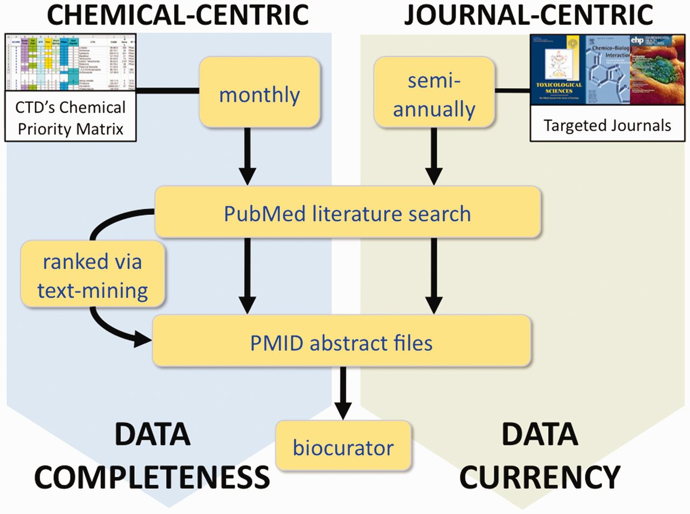
Figure 6 CTD’s two complementary processes for literature selection and curation. In the chemical-centric approach, ...
Notes:
Figure 6 CTD’s two complementary processes for literature selection and curation. In the chemical-centric approach, each month we select several chemicals-of-interest from our Chemical Priority Matrix to query PubMed for all the literature (both current and legacy) for each chemical. Depending upon the size of the corpus, either all the abstracts are sent to the biocurator, or they are first processed through CTD’s text-mining algorithm to rank and prioritize the papers based upon data content. This approach results in data completeness for the chemical. In the journal-centric approach, we could retrieve the complete set of articles for selected targeted journals on a regular basis (perhaps semi-annually), providing a corpus of research papers that more accurately reflects the current state of toxicogenomics, regardless of any chemical bias. This method results in improved overall data currency at CTD.
Unless provided in the caption above, the following copyright applies to the content of this slide: © The Author(s) 2012. Published by Oxford University Press.This is an Open Access article distributed under the terms of the Creative Commons Attribution License (http://creativecommons.org/licenses/by-nc/3.0/), which permits non-commercial reuse, distribution, and reproduction in any medium, provided the original work is properly cited. For commercial re-use, please contact journals.permissions@oup.com.

