Slide 1
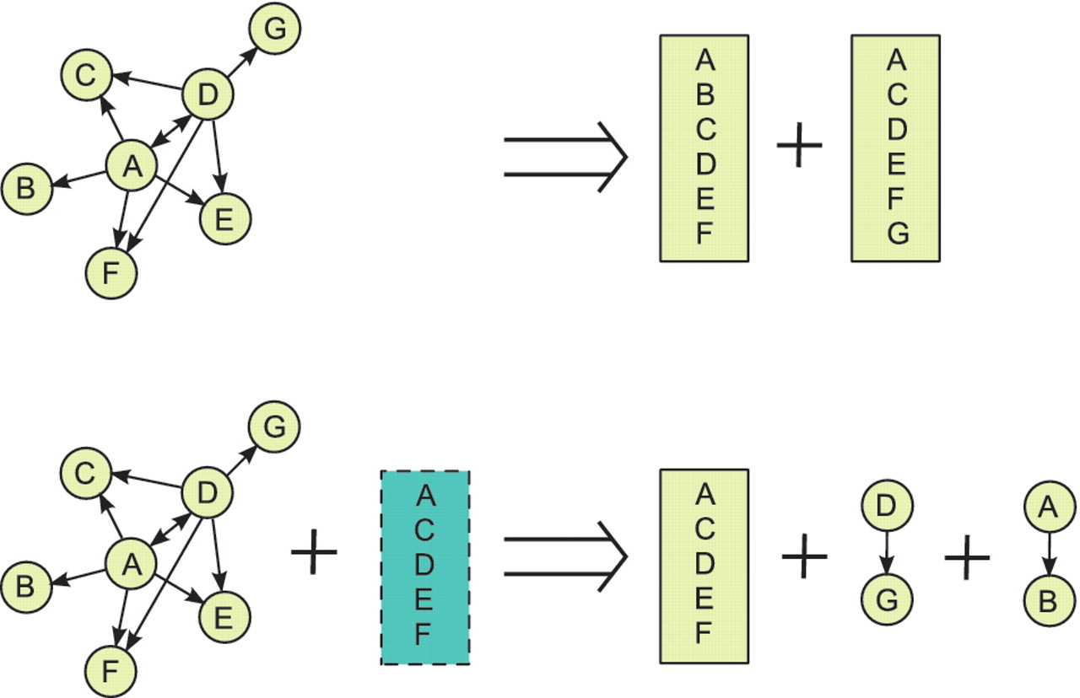
Figure 1. ppiTrim uses two procedures for complex deflation: pattern detection (top) and template matching (bottom). As ...
Notes:
Figure 1. ppiTrim uses two procedures for complex deflation: pattern detection (top) and template matching (bottom). As an example, assume that a graph ABCDEFG, shown on the left, could be constructed from complex candidate interactions annotated by the BioGRID from a single publication. The arrows indicate bait to prey relationships, with the interaction A–D being repeated twice, once with A and once with D as a bait. Pattern-detection algorithm (top) would recognize A and D as hubs of potentially spoke-expanded complexes and thus replace all pairwise interactions on the left with complexes ABCDEF and ACDEFG. Suppose that the complex ACDEF was reported from the same publication by a different database. Then, template matching procedure (bottom) would generate the complex ACDEF (with all other annotation, such as experimental detection method, retained from the original interactions) and remove all original interactions except D–G and A–B. After performing both procedures, ppiTrim consolidates the results so that the overall result would be replacing the original interactions by complexes ACDEF, ABCDEF and ACDEFG with edge type codes `R', `A' and `A', respectively. The interactions A–B and D–G would not be retained since they are contained within the deflated complexes ABCDEF and ACDEFG.
Unless provided in the caption above, the following copyright applies to the content of this slide: Published by Oxford University Press 2011.This is Open Access article distributed under the terms of the Creative Commons Attribution Non-Commercial License (http://creativecommons.org/licenses/by-nc/2.5), which permits unrestricted non-commercial use, distribution, and reproduction in any medium, provided the original work is properly cited.

