Slide 1
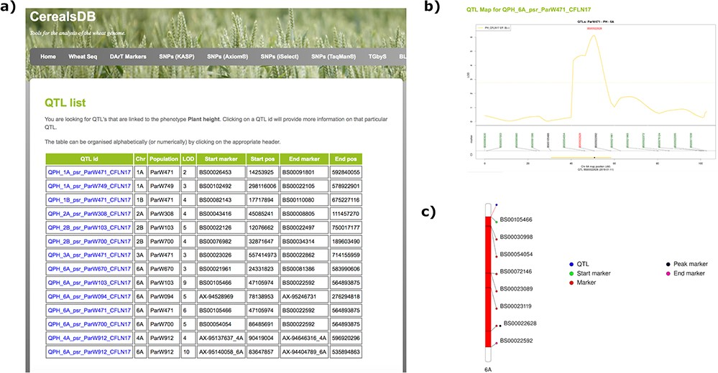
Figure 1. Searching the QTL database for a particular phenotype generates a table (a) displaying all QTLs for that ...
Notes:
Figure 1. Searching the QTL database for a particular phenotype generates a table (a) displaying all QTLs for that phenotype along with chromosomal positions, population information and LOD scores. Clicking on an individual QTL links to QTL maps (b) where markers are shown at the start and end of the confidence interval of the QTL along with the peak marker. An ideogram of the chromosome (c) is also displayed where available showing the QTL highlighted in red and the chromosomal position of important markers are also highlighted.
Unless provided in the caption above, the following copyright applies to the content of this slide: © The Author(s) 2020. Published by Oxford University Press.This is an Open Access article distributed under the terms of the Creative Commons Attribution License (http://creativecommons.org/licenses/by/4.0/), which permits unrestricted reuse, distribution, and reproduction in any medium, provided the original work is properly cited.

Slide 2
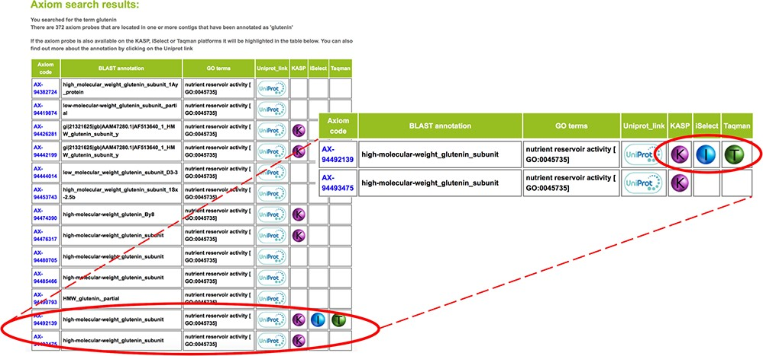
Figure 2. Colour-coded glyphs allow users to rapidly scroll through hundreds of results and identify cross-platform ...
Notes:
Figure 2. Colour-coded glyphs allow users to rapidly scroll through hundreds of results and identify cross-platform SNPs, which is a useful tool for plant breeders that often require ‘legacy’ markers for their breeding programmes.
Unless provided in the caption above, the following copyright applies to the content of this slide: © The Author(s) 2020. Published by Oxford University Press.This is an Open Access article distributed under the terms of the Creative Commons Attribution License (http://creativecommons.org/licenses/by/4.0/), which permits unrestricted reuse, distribution, and reproduction in any medium, provided the original work is properly cited.

Slide 3
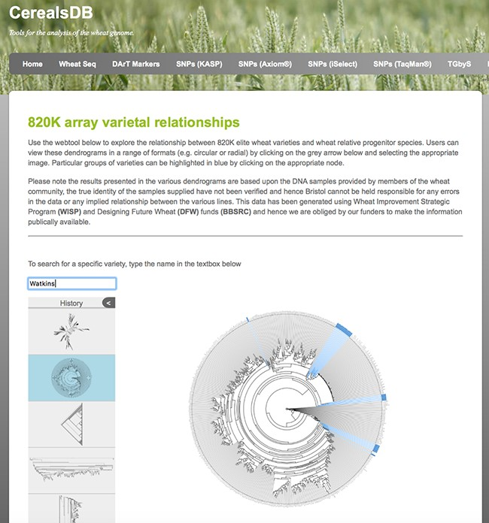
Figure 3. A circular dendrogram rendered using phylocanvas shows Watkins lines highlighted in blue. Users can view ...
Notes:
Figure 3. A circular dendrogram rendered using phylocanvas shows Watkins lines highlighted in blue. Users can view relationships between wheat varieties genotyped on both the 820K and 35K arrays and display the data in a number of different styles of dendrogram.
Unless provided in the caption above, the following copyright applies to the content of this slide: © The Author(s) 2020. Published by Oxford University Press.This is an Open Access article distributed under the terms of the Creative Commons Attribution License (http://creativecommons.org/licenses/by/4.0/), which permits unrestricted reuse, distribution, and reproduction in any medium, provided the original work is properly cited.

Slide 4
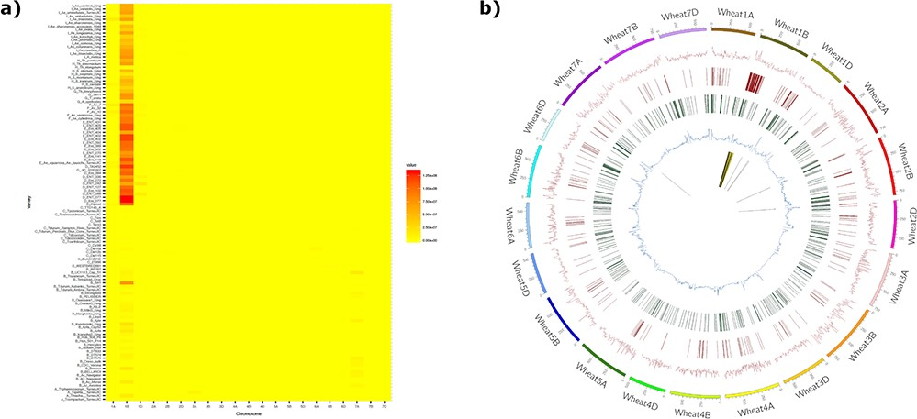
Figure 4. The introgression plotter generates a heatmap and a circos plot in this example for the variety Brompton. The ...
Notes:
Figure 4. The introgression plotter generates a heatmap and a circos plot in this example for the variety Brompton. The heatmap (a) plots total introgression size for each comparison with relatives ordered vertically by relatedness to bread wheat and chromosomes ordered horizontally. Users can zoom in on the heatmap for more detail. The circos plot (b) has a number of tracks: track 1 (innermost track), putative introgressed/deleted regions; track 2, SNP density for each wheat chromosome; track 3, CNV gain; track 4, CNV loss; track 5, minor allele frequency. The outermost track represents wheat chromosomes (500 = 500 Mbp). The Brompton wheat variety is known to have the 1B/1RS translocation and this can clearly be seen in the circos plot.
Unless provided in the caption above, the following copyright applies to the content of this slide: © The Author(s) 2020. Published by Oxford University Press.This is an Open Access article distributed under the terms of the Creative Commons Attribution License (http://creativecommons.org/licenses/by/4.0/), which permits unrestricted reuse, distribution, and reproduction in any medium, provided the original work is properly cited.

