Slide 1
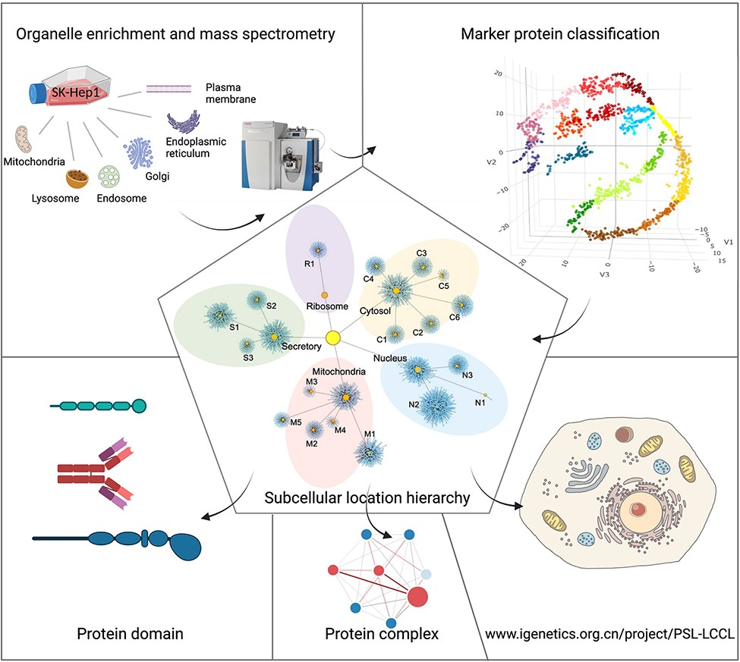
Figure 1. A graphical abstract for the present study. Six cytosolic membrane-bound organelles were isolated and ...
Notes:
Figure 1. A graphical abstract for the present study. Six cytosolic membrane-bound organelles were isolated and enriched from SK_HEP1, and proteins in each organelle were quantified by MS. A compiled list of marker proteins was clustered and trained using a machine-learning-based algorithm. All proteins were localized at the cluster and neighborhood levels, respectively, as shown in a hierarchical structure. The localization of protein domains and complexes was further investigated. The proteome for subcellular organelles was available at www.igenetics.org.cn/PSL-LCCL.
Unless provided in the caption above, the following copyright applies to the content of this slide: © The Author(s) 2022. Published by Oxford University Press.This is an Open Access article distributed under the terms of the Creative Commons Attribution License (https://creativecommons.org/licenses/by/4.0/), which permits unrestricted reuse, distribution, and reproduction in any medium, provided the original work is properly cited.

