Slide 1
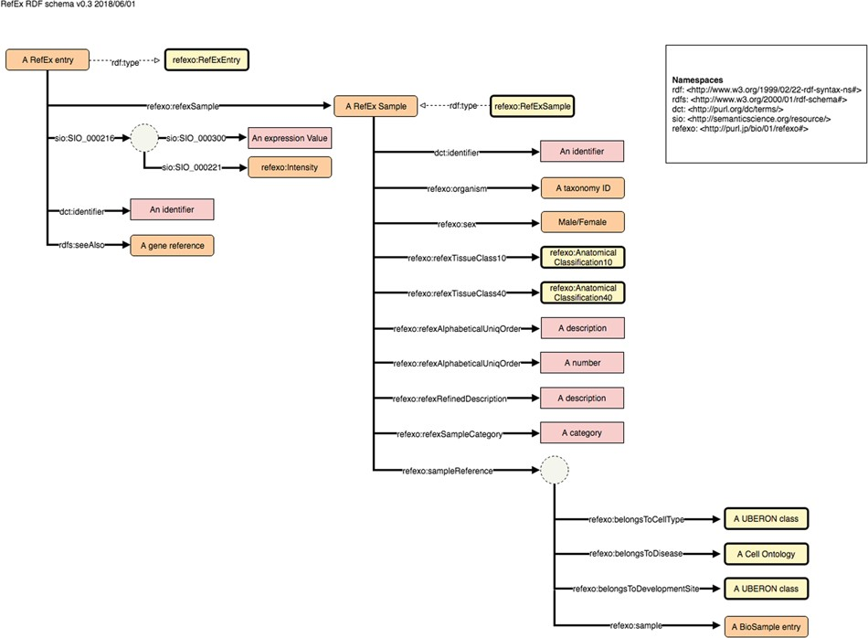
Figure 3 Example schema diagram from the NBDC RDF portal. This example schema diagram is taken from the RefEx RDF. The ...
Notes:
Figure 3 Example schema diagram from the NBDC RDF portal. This example schema diagram is taken from the RefEx RDF. The orange, yellow and pink rectangles represent instances, ontology classes and literals, respectively; the solid and dashed arrows represent properties and rdf:type relationships; the dotted circles represent blank nodes.
Unless provided in the caption above, the following copyright applies to the content of this slide: © The Author(s) 2018. Published by Oxford University Press. All rights reserved. For Permissions, please email: journals.permissions@oup.comThis article is published and distributed under the terms of the Oxford University Press, Standard Journals Publication Model (https://academic.oup.com/journals/pages/open_access/funder_policies/chorus/standard_publication_model)

