Slide 1
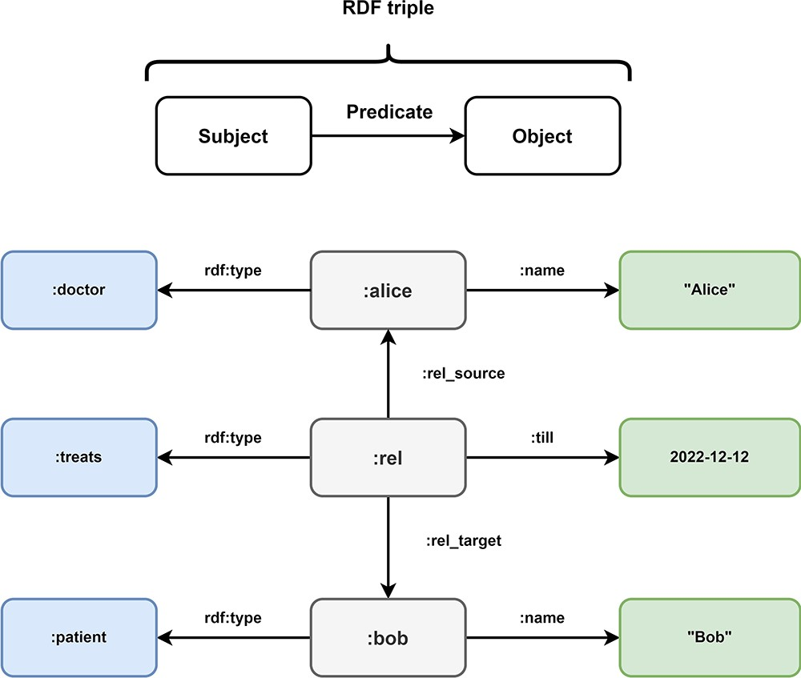
Figure 7. Overview of Resource Description Framework (RDF). Every information in the Resource Description Framework is ...
Notes:
Figure 7. Overview of Resource Description Framework (RDF). Every information in the Resource Description Framework is organized as a triple and every triple follows a subject predicate object structure. In this example, the medical data of Figure 5 is transformed into the RDF format. The subject:alice has the predicate rdf:type with the object:doctor and the predicate:name with object ‘Alice’. These RDF triples represent the node of doctor Alice in the LPG. The directed nature of the edge TREATS in the LPG is represented by the RDF triples (:rel,:rel_source,:alice) and (:rel,:rel_target,:bob). The properties of the edge are represented by the triples (:rel, rdf:type,:treats) and (:rel,:till, 2022–12-12). Bob is represented by the triples (:bob, rdf:type,:patient) and (:bob,:name, “Bob).
Unless provided in the caption above, the following copyright applies to the content of this slide: © The Author(s) 2024. Published by Oxford University Press.This is an Open Access article distributed under the terms of the Creative Commons Attribution License (https://creativecommons.org/licenses/by/4.0/), which permits unrestricted reuse, distribution, and reproduction in any medium, provided the original work is properly cited.

