Slide 1
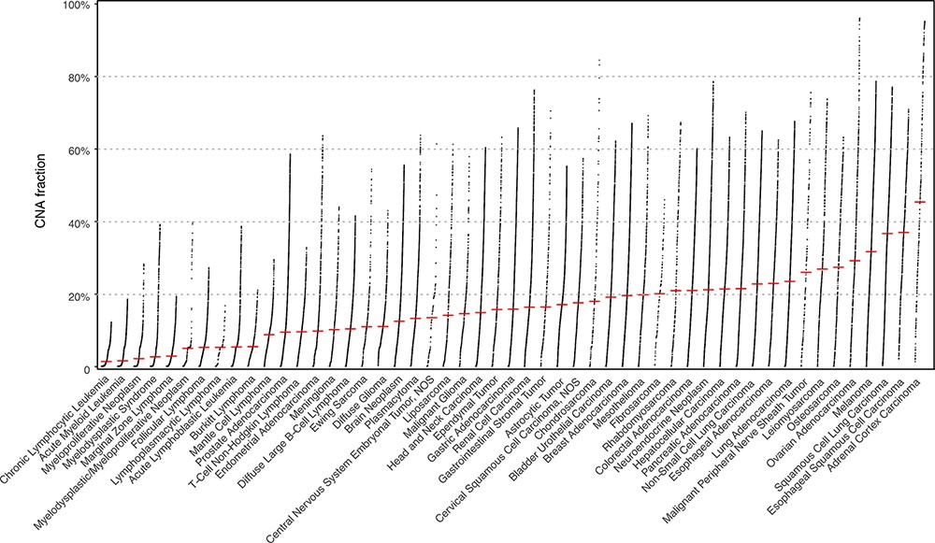
Figure 1. The currently available CNA data points in Progenetix and TCGA Progenetix database contain 115 357 cancer ...
Notes:
Figure 1. The currently available CNA data points in Progenetix and TCGA Progenetix database contain 115 357 cancer samples with 92 307 mapped to the 51 defined critical nodes in NCIt ontology tree and 23 050 samples not mapped to the tree (black), whereas TCGA repository contains 11 090 samples with 9103 samples mapped and 1987 samples not mapped to the tree (black). Colors of the stacked bar plot (left) match the branch colors on NCIt ontology tree (right).
Unless provided in the caption above, the following copyright applies to the content of this slide: © The Author(s) 2021. Published by Oxford University Press.This is an Open Access article distributed under the terms of the Creative Commons Attribution License (http://creativecommons.org/licenses/by/4.0/), which permits unrestricted reuse, distribution, and reproduction in any medium, provided the original work is properly cited.

