Slide 1
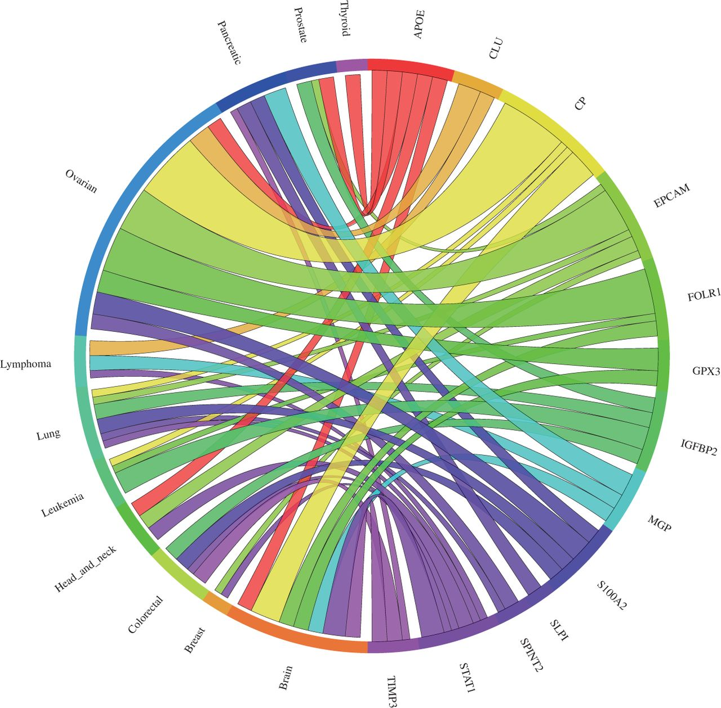
Figure 4 Circos plot showing the meta-change in gene expression in relation to corresponding cancer types. The plot ...
Notes:
Figure 4 Circos plot showing the meta-change in gene expression in relation to corresponding cancer types. The plot shows the meta-upregulated genes of the validation dataset from Hough et al. (30): The expression of the genes GPX3, CLU, EPCAM, SPINT2, FOLR1, S100A2, APOE and CP was found to be upregulated in ovarian cancer consistent with the published results. Each connection between a gene and a cancer type indicates a statistically significant mean up- or downregulation for that cancer type derived from a number of combined array studies for cancer tissue versus normal tissue. The weight of the connection corresponds to the magnitude of the meta-change in gene expression.
Unless provided in the caption above, the following copyright applies to the content of this slide: © The Author(s) 2012. Published by Oxford University Press.This is an Open Access article distributed under the terms of the Creative Commons Attribution Non-Commercial License (http://creativecommons.org/licenses/by-nc/3.0/), which permits unrestricted non-commercial use, distribution, and reproduction in any medium, provided the original work is properly cited.

