Slide 1
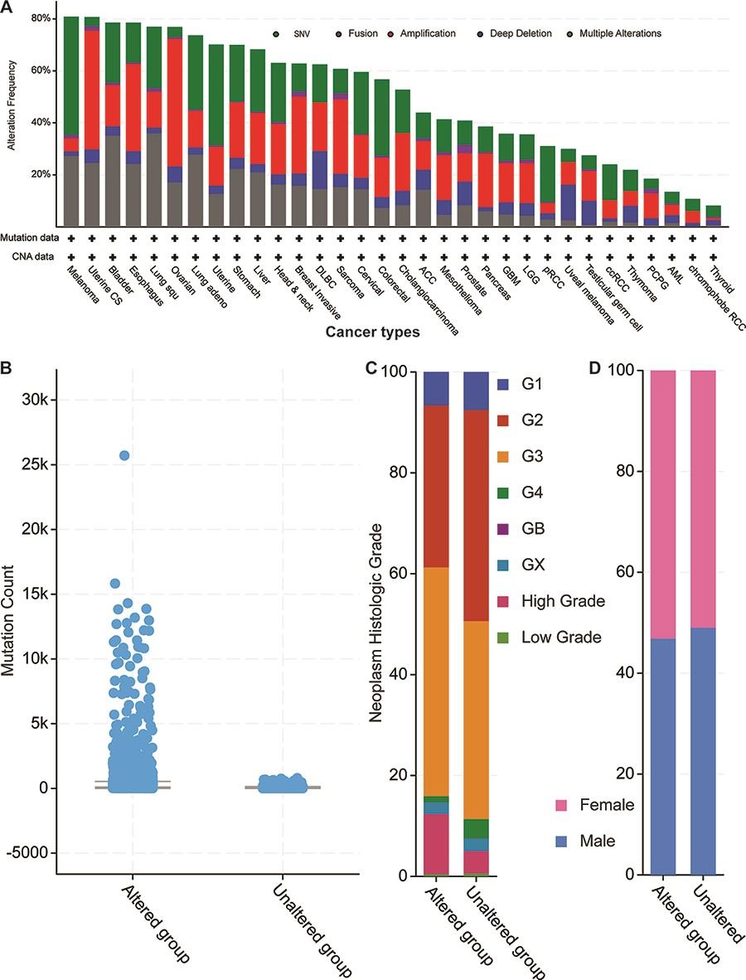
Figure 4. Cancer genomics overview of the 52 circRNA differentially expressed parental genes in 32 TCGA studies. (A) ...
Notes:
Figure 4. Cancer genomics overview of the 52 circRNA differentially expressed parental genes in 32 TCGA studies. (A) Mutational frequencies in various cancer types. (B) The mutation counts for those samples with (altered) or without (unaltered) genetic variants among the 52 genes. (C) The histological grade distributions for those samples with or without genetic variants among the 52 genes. (D) Gender ratios for those samples with or without genetic variants among the 52 genes.
Unless provided in the caption above, the following copyright applies to the content of this slide: © The Author(s) 2021. Published by Oxford University Press.This is an Open Access article distributed under the terms of the Creative Commons Attribution License (http://creativecommons.org/licenses/by/4.0/), which permits unrestricted reuse, distribution, and reproduction in any medium, provided the original work is properly cited.

