Slide 1
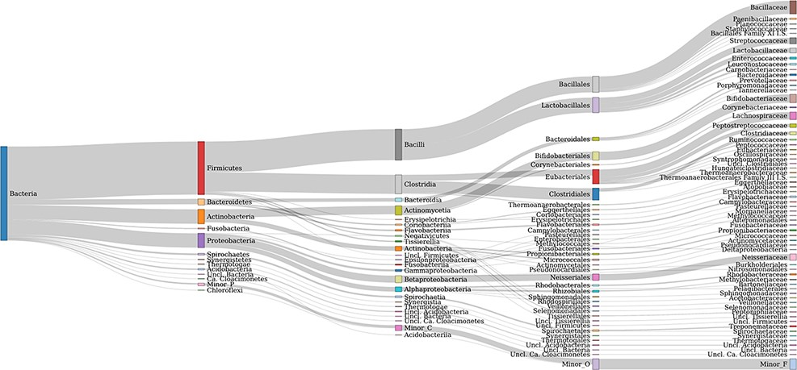
Figure 1. Taxonomic coverage up to the family level of FTHFS sequences present in the AcetoBase reference protein data ...
Notes:
Figure 1. Taxonomic coverage up to the family level of FTHFS sequences present in the AcetoBase reference protein data set. Candidates with <50 sequences are merged in minor taxa.
Unless provided in the caption above, the following copyright applies to the content of this slide: © The Author(s) 2022. Published by Oxford University Press.This is an Open Access article distributed under the terms of the Creative Commons Attribution-NonCommercial License (https://creativecommons.org/licenses/by-nc/4.0/), which permits non-commercial re-use, distribution, and reproduction in any medium, provided the original work is properly cited. For commercial re-use, please contact journals.permissions@oup.com

Slide 2
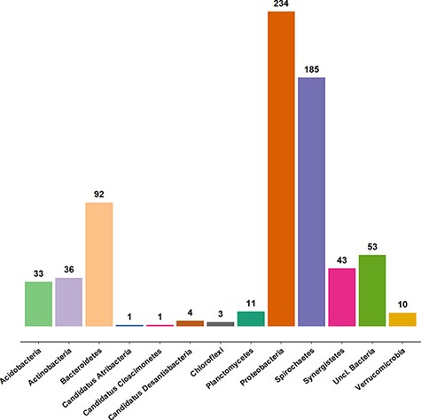
Figure 2. Taxonomic coverage of the clone sequence data set of AcetoBase at the phylum level, excluding Firmicutes ...
Notes:
Figure 2. Taxonomic coverage of the clone sequence data set of AcetoBase at the phylum level, excluding Firmicutes (n = 2355 sequences). The values shown represent the sequence count for the respective phylum present in the AcetoBase clone data set.
Unless provided in the caption above, the following copyright applies to the content of this slide: © The Author(s) 2022. Published by Oxford University Press.This is an Open Access article distributed under the terms of the Creative Commons Attribution-NonCommercial License (https://creativecommons.org/licenses/by-nc/4.0/), which permits non-commercial re-use, distribution, and reproduction in any medium, provided the original work is properly cited. For commercial re-use, please contact journals.permissions@oup.com

Slide 3
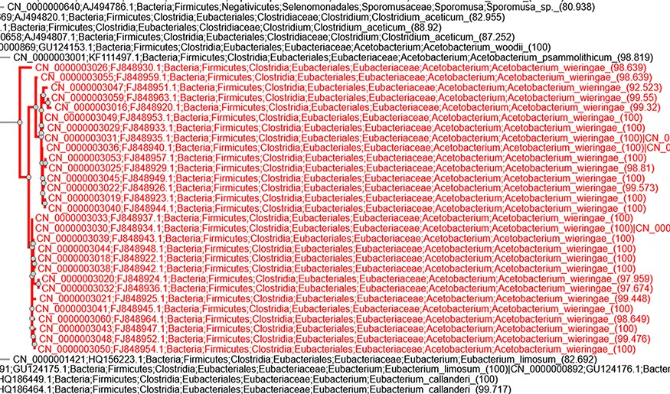
Figure 3. Screenshot of taxonomic annotation and placement of clone sequences associated with the study by Parameswaran ...
Notes:
Figure 3. Screenshot of taxonomic annotation and placement of clone sequences associated with the study by Parameswaran et al. (14) in the AcetoBase clone phylogenetic tree available at https://acetobase.molbio.slu.se/phylo/clone.
Unless provided in the caption above, the following copyright applies to the content of this slide: © The Author(s) 2022. Published by Oxford University Press.This is an Open Access article distributed under the terms of the Creative Commons Attribution-NonCommercial License (https://creativecommons.org/licenses/by-nc/4.0/), which permits non-commercial re-use, distribution, and reproduction in any medium, provided the original work is properly cited. For commercial re-use, please contact journals.permissions@oup.com

Slide 4
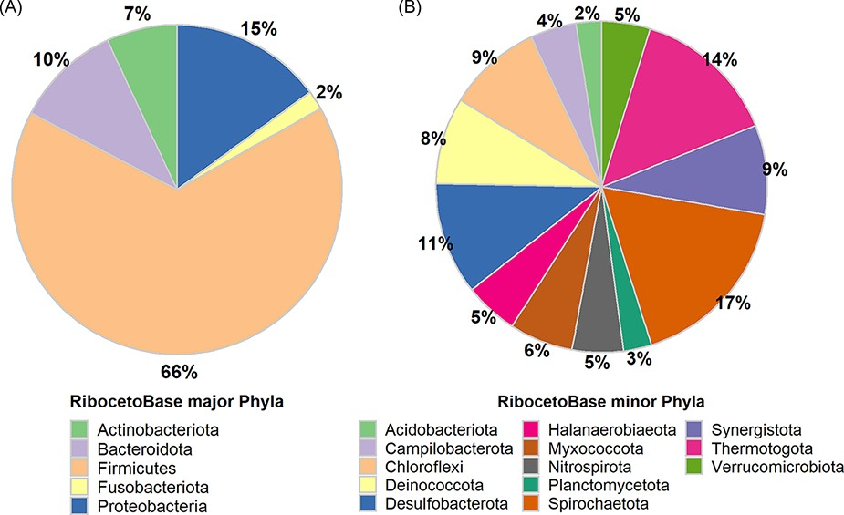
Figure 4. Taxonomic distribution in the RibocetoBase data set of FTHFS-harbouring communities present in AcetoBase at ...
Notes:
Figure 4. Taxonomic distribution in the RibocetoBase data set of FTHFS-harbouring communities present in AcetoBase at the phylum level. (A) Major phyla with >100 sequences and (B) minor phyla with sequence count 10–100.
Unless provided in the caption above, the following copyright applies to the content of this slide: © The Author(s) 2022. Published by Oxford University Press.This is an Open Access article distributed under the terms of the Creative Commons Attribution-NonCommercial License (https://creativecommons.org/licenses/by-nc/4.0/), which permits non-commercial re-use, distribution, and reproduction in any medium, provided the original work is properly cited. For commercial re-use, please contact journals.permissions@oup.com

Slide 5
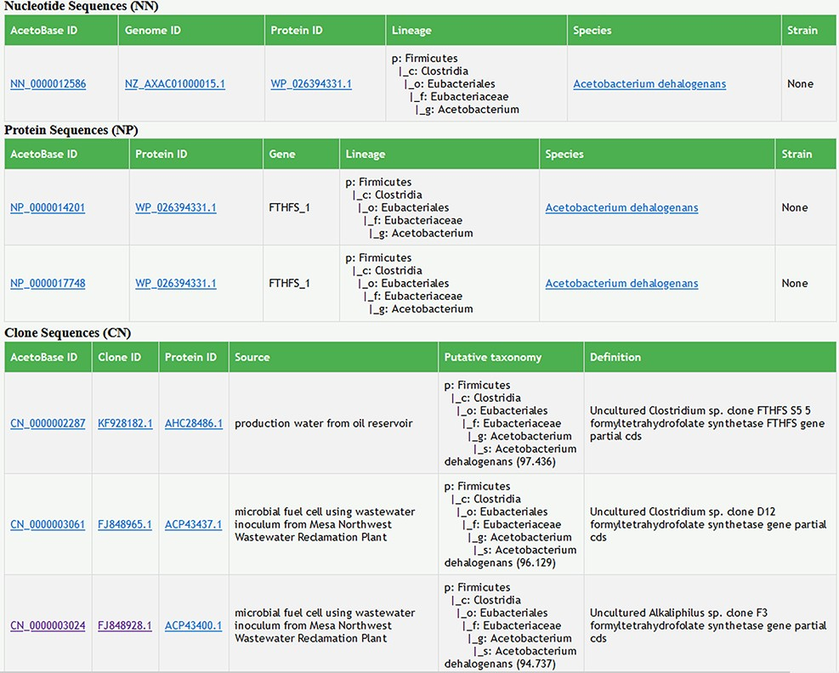
Figure 5. Screenshot of search results in AcetoBase Version 2 showing taxonomic lineages of the query against the ...
Notes:
Figure 5. Screenshot of search results in AcetoBase Version 2 showing taxonomic lineages of the query against the nucleotide and protein data sets. The search results for the clone data set show the isolation source of the clone, its description/definition and the putative taxonomy predicted with the acetotax program.
Unless provided in the caption above, the following copyright applies to the content of this slide: © The Author(s) 2022. Published by Oxford University Press.This is an Open Access article distributed under the terms of the Creative Commons Attribution-NonCommercial License (https://creativecommons.org/licenses/by-nc/4.0/), which permits non-commercial re-use, distribution, and reproduction in any medium, provided the original work is properly cited. For commercial re-use, please contact journals.permissions@oup.com

