Slide 1
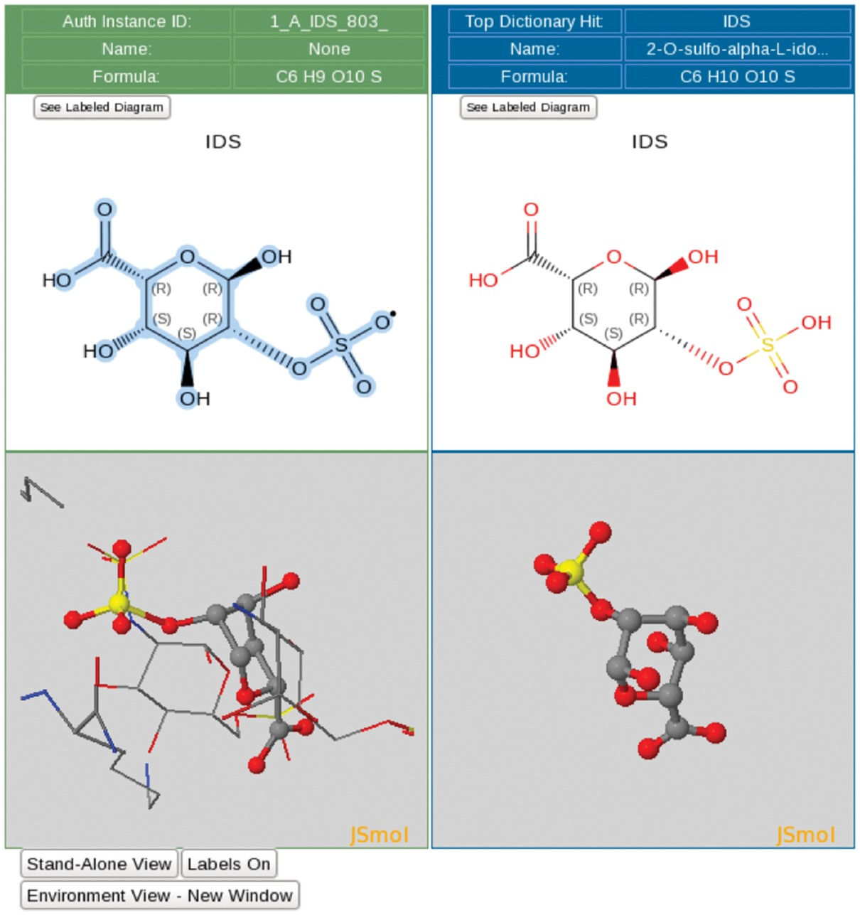
Figure 3. Ligand processing. The ligand processing module enables comparison of the structure of the deposited ligand ...
Notes:
Figure 3. Ligand processing. The ligand processing module enables comparison of the structure of the deposited ligand with matches from the CCD. The top panels compare 2D structures, and the bottom panels compare 3D views of the model with matched ligands.
Unless provided in the caption above, the following copyright applies to the content of this slide: © The Author(s) 2018. Published by Oxford University Press.This is an Open Access article distributed under the terms of the Creative Commons Attribution License (http://creativecommons.org/licenses/by/4.0/), which permits unrestricted reuse, distribution, and reproduction in any medium, provided the original work is properly cited.

