Slide 1
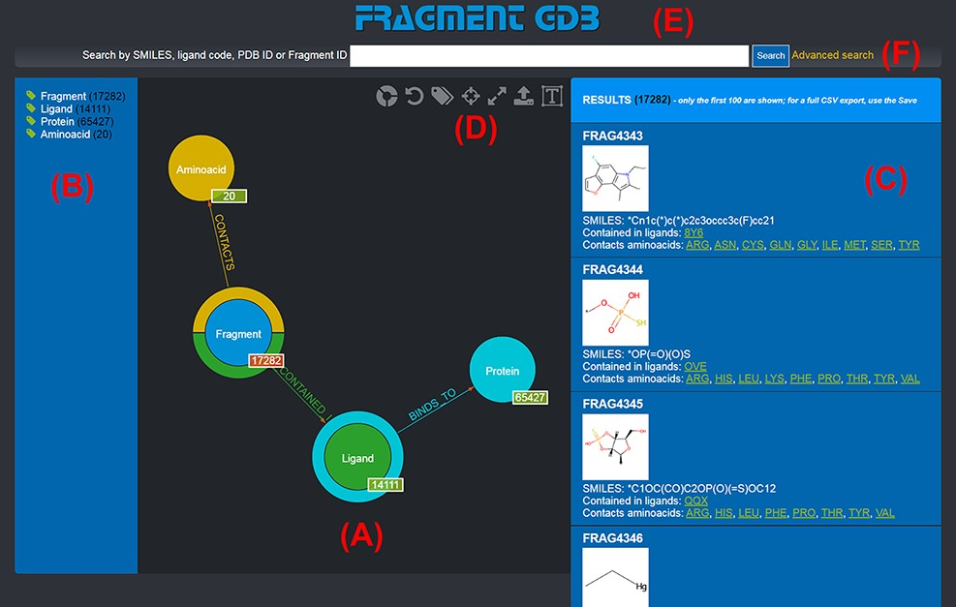
Figure 1. Landing page of the FGDB. (A) The main panel of the graph database, where the entities and their ...
Notes:
Figure 1. Landing page of the FGDB. (A) The main panel of the graph database, where the entities and their relationships are shown and which allows users to browse the data and perform graphical queries for filtering them out. (B) The left side taxonomical panel shows the types and number of entities stored in FGDB; it is immutable regardless of the queries performed and allows users to individually filter a specific type of entity to be visualized. (C) The right side panel shows a subset (up to 100) of the Fragments resulting from the currently executed query, displaying the number of the total results and providing, for each entity shown, its corresponding information in terms of identifier, molecular structure, SMILES, list of ligands where the Fragment is contained and list of amino acids contacted; the latter two are hyperlinked with the corresponding entry of the PDB. (D) Upper toolbar of the main panel, providing users with a number of useful functionalities, from left to right: hiding/showing clickable relationships around the entities (the colored crowns/half-crowns around the Fragment and Ligand nodes), resetting the graph to the last executed query, hiding/showing the left taxonomical panel, centering the graph, making the graph full-screen, exporting the current graph and enlarging/shrinking the size of the nodes’ textual labels. (E) The basic search field where users may search for Fragments by SMILES of the Fragment, ligand code of the contained ligands, PDB ID of the proteins the contained ligands bind to or Fragment identifier. (F) The hyperlink to the advanced search panel, where users may carry out more complex queries against the database.
Unless provided in the caption above, the following copyright applies to the content of this slide: © The Author(s) 2022. Published by Oxford University Press.This is an Open Access article distributed under the terms of the Creative Commons Attribution-NonCommercial License (https://creativecommons.org/licenses/by-nc/4.0/), which permits non-commercial re-use, distribution, and reproduction in any medium, provided the original work is properly cited. For commercial re-use, please contact journals.permissions@oup.com

Slide 2
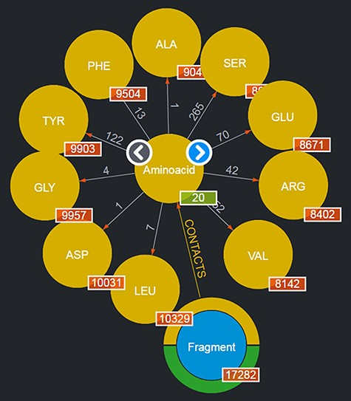
Figure 2. Entities of type ‘Aminoacids’ shown after clicking on the corresponding entity type node. The view shows up ...
Notes:
Figure 2. Entities of type ‘Aminoacids’ shown after clicking on the corresponding entity type node. The view shows up to 10 entities and allows users to browse for more by using the left/right arrows in the center. The numbers displayed on the edges, in this case, correspond to the total number of Fragments featured in the DB contacting the given amino acid.
Unless provided in the caption above, the following copyright applies to the content of this slide: © The Author(s) 2022. Published by Oxford University Press.This is an Open Access article distributed under the terms of the Creative Commons Attribution-NonCommercial License (https://creativecommons.org/licenses/by-nc/4.0/), which permits non-commercial re-use, distribution, and reproduction in any medium, provided the original work is properly cited. For commercial re-use, please contact journals.permissions@oup.com

Slide 3
Figure 3. Output of a basic query where the user had looked for ‘M4O’. The results page shows the searched ligand ...
Notes:
Figure 3. Output of a basic query where the user had looked for ‘M4O’. The results page shows the searched ligand instead of the generic ligand entity type in the graph, along with the number of Fragments that ligand contains (in this case, 27) and the number of proteins it binds to (in this case, 1); the 27 Fragments contact as a whole all of the 20 amino acids; thus, 20 is displayed as their number. By clicking on the corresponding entity type node (e.g. Fragment), it is possible to browse each of the entities returned and in the case of Fragments to see their details on the rightmost panel as well (not shown in the figure).
Unless provided in the caption above, the following copyright applies to the content of this slide: © The Author(s) 2022. Published by Oxford University Press.This is an Open Access article distributed under the terms of the Creative Commons Attribution-NonCommercial License (https://creativecommons.org/licenses/by-nc/4.0/), which permits non-commercial re-use, distribution, and reproduction in any medium, provided the original work is properly cited. For commercial re-use, please contact journals.permissions@oup.com

Slide 4
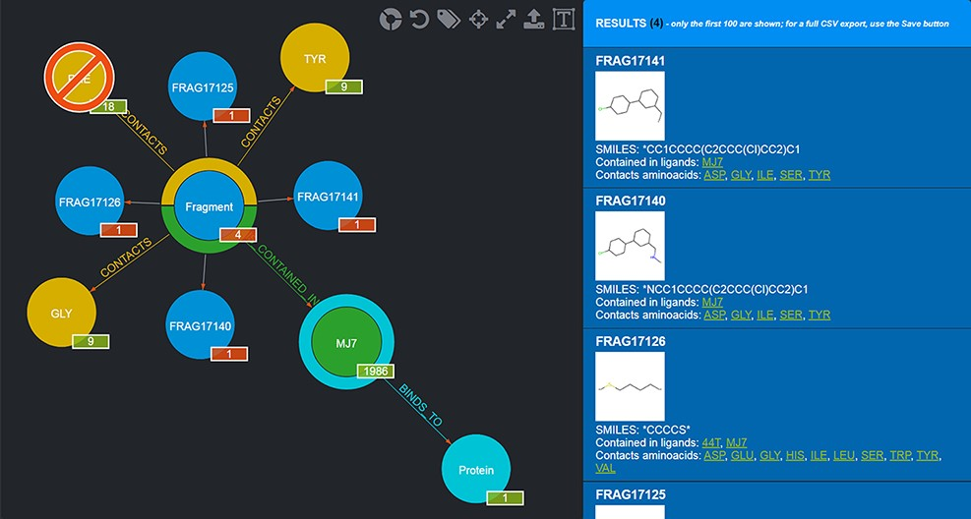
Figure 4. Example of a graphical query. The query performed shows those Fragments that contact both TYR and GLY but not ...
Notes:
Figure 4. Example of a graphical query. The query performed shows those Fragments that contact both TYR and GLY but not PHE and are contained in MJ7. This view was thus produced by filtering Fragments as follows: firstly, by clicking on the Aminoacid node and selecting TYR by clicking on it; secondly, by clicking on the yellow half-crown around the Fragment node for bringing up another ‘CONTACTS’ relationship and doing the same selection as before for GLY; thirdly, by repeating the previous step, but this time using CTRL + click to select PHE, in order to negate the relationship; fourthly, clicking on the Ligand node and selecting MJ7; finally, by clicking on the Fragment node (whose amount was reduced to 4, i.e. the only Fragments fulfilling the selected conditions) and displaying the actual Fragments resulting from the query; their details are shown in the right-side panel. The numbers on the bottom right of the nodes have the following semantics: the numbers in the red background refer to the resulting Fragments (4 total, each Fragment showing 1 as they are indeed individual); the other numbers refer to the Aminoacids they contact as a whole (9), the total number of Ligands that Fragments contacting the chosen Aminoacids are contained in (1986) and the number of proteins the selected ligand (MJ7) binds to (1).
Unless provided in the caption above, the following copyright applies to the content of this slide: © The Author(s) 2022. Published by Oxford University Press.This is an Open Access article distributed under the terms of the Creative Commons Attribution-NonCommercial License (https://creativecommons.org/licenses/by-nc/4.0/), which permits non-commercial re-use, distribution, and reproduction in any medium, provided the original work is properly cited. For commercial re-use, please contact journals.permissions@oup.com

Slide 5
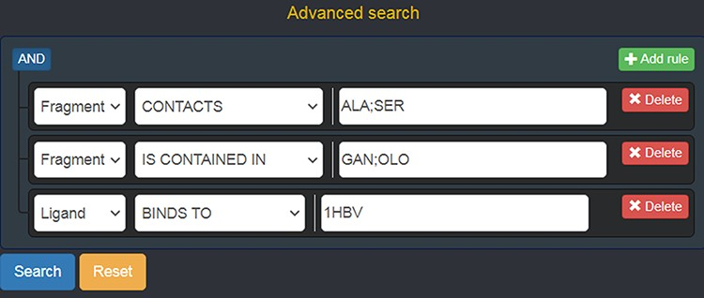
Figure 5. Advanced search panel, with some text fields populated as an example. The semantics of the query shown here ...
Notes:
Figure 5. Advanced search panel, with some text fields populated as an example. The semantics of the query shown here is the following: “retrieve all of the Fragments which contact the amino acids ALA or SER, AND which are contained in the ligands with code GAN or OLO, AND whose containing Ligands bind to the protein identified by the PDB ID 1 HBV.
Unless provided in the caption above, the following copyright applies to the content of this slide: © The Author(s) 2022. Published by Oxford University Press.This is an Open Access article distributed under the terms of the Creative Commons Attribution-NonCommercial License (https://creativecommons.org/licenses/by-nc/4.0/), which permits non-commercial re-use, distribution, and reproduction in any medium, provided the original work is properly cited. For commercial re-use, please contact journals.permissions@oup.com

Slide 6
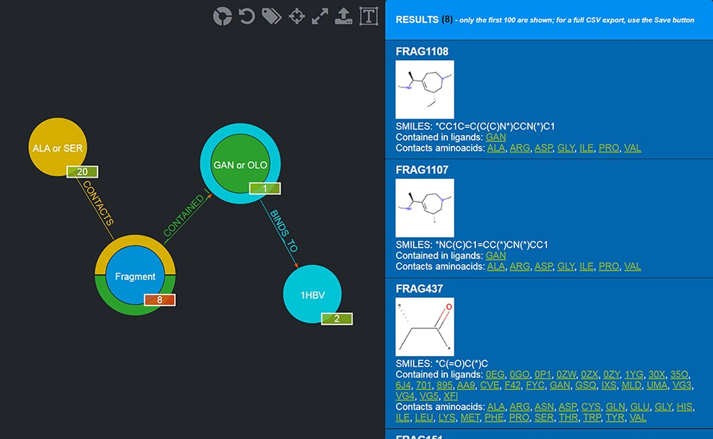
Figure 6. Results of the advanced query shown in Figure 5. Twenty-eight Fragments are returned (whose details are ...
Notes:
Figure 6. Results of the advanced query shown in Figure 5. Twenty-eight Fragments are returned (whose details are provided in the rightmost panel).
Unless provided in the caption above, the following copyright applies to the content of this slide: © The Author(s) 2022. Published by Oxford University Press.This is an Open Access article distributed under the terms of the Creative Commons Attribution-NonCommercial License (https://creativecommons.org/licenses/by-nc/4.0/), which permits non-commercial re-use, distribution, and reproduction in any medium, provided the original work is properly cited. For commercial re-use, please contact journals.permissions@oup.com

Slide 7
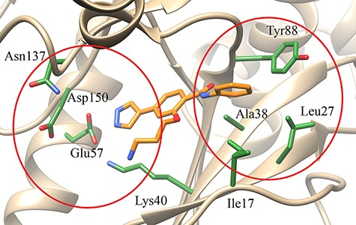
Figure 7. Schematic representation of the MELK in complex with the inhibitor ...
Notes:
Figure 7. Schematic representation of the MELK in complex with the inhibitor 3-[2-(phenylcarbamoyl)-5-(1H-pyrazol-4-yl)phenoxy]propan-1-aminium developed by a FBDD approach. The red ellipses indicate the two subpockets of the active site in which inhibitors bind [PDB code: 4D2T (34)].
Unless provided in the caption above, the following copyright applies to the content of this slide: © The Author(s) 2022. Published by Oxford University Press.This is an Open Access article distributed under the terms of the Creative Commons Attribution-NonCommercial License (https://creativecommons.org/licenses/by-nc/4.0/), which permits non-commercial re-use, distribution, and reproduction in any medium, provided the original work is properly cited. For commercial re-use, please contact journals.permissions@oup.com

Slide 8
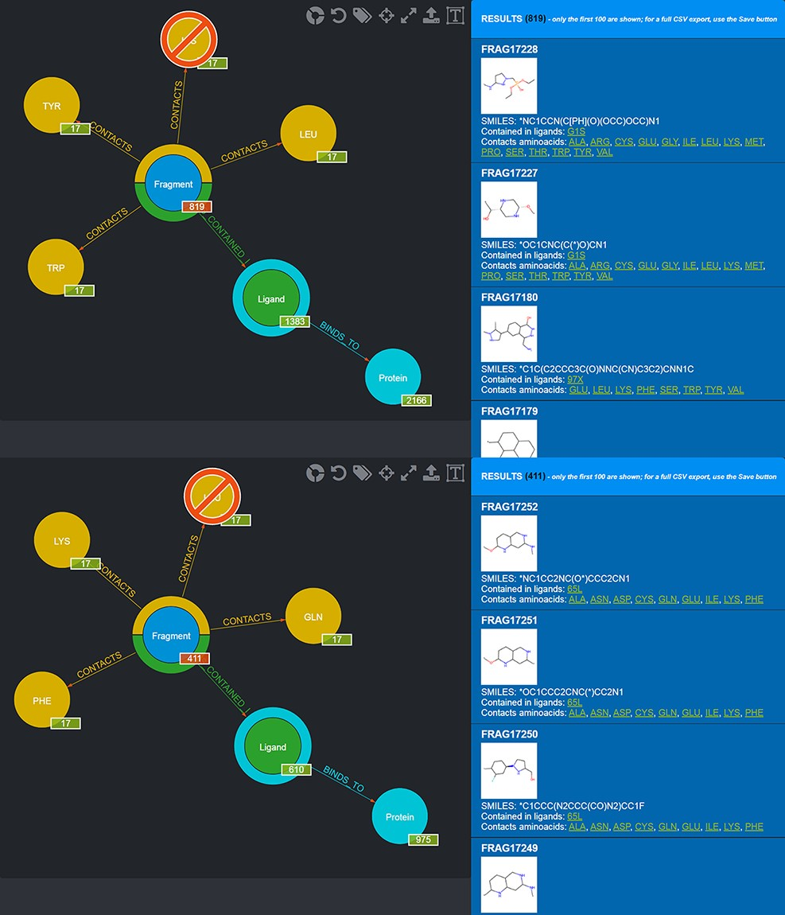
Figure 8. Screenshot of the graphical queries done to extract from the database those fragments observed to contact the ...
Notes:
Figure 8. Screenshot of the graphical queries done to extract from the database those fragments observed to contact the amino acids lining the first (top panel) and the second (bottom panel) subpocket of MELK with, on the right side, a preview of the results of the queries.
Unless provided in the caption above, the following copyright applies to the content of this slide: © The Author(s) 2022. Published by Oxford University Press.This is an Open Access article distributed under the terms of the Creative Commons Attribution-NonCommercial License (https://creativecommons.org/licenses/by-nc/4.0/), which permits non-commercial re-use, distribution, and reproduction in any medium, provided the original work is properly cited. For commercial re-use, please contact journals.permissions@oup.com

Slide 9
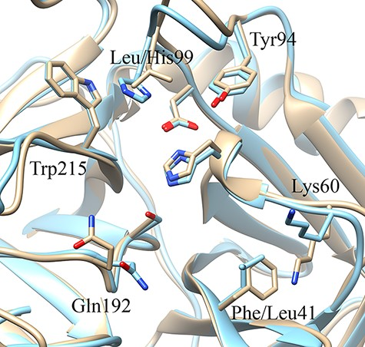
Figure 9. Schematic representation of the three-dimensional structure of the oncogenic protease mesotrypsin [light ...
Notes:
Figure 9. Schematic representation of the three-dimensional structure of the oncogenic protease mesotrypsin [light brown, PDB ID 3L33 (36)] and the closely related kallikrein-6 [blue, PDB ID 1L2E (37)] highlighting similarities and differences in the two subpockets adjacent to the catalytic triad (unlabeled Ser, His and Asp residues) on opposite sides.
Unless provided in the caption above, the following copyright applies to the content of this slide: © The Author(s) 2022. Published by Oxford University Press.This is an Open Access article distributed under the terms of the Creative Commons Attribution-NonCommercial License (https://creativecommons.org/licenses/by-nc/4.0/), which permits non-commercial re-use, distribution, and reproduction in any medium, provided the original work is properly cited. For commercial re-use, please contact journals.permissions@oup.com

Slide 10
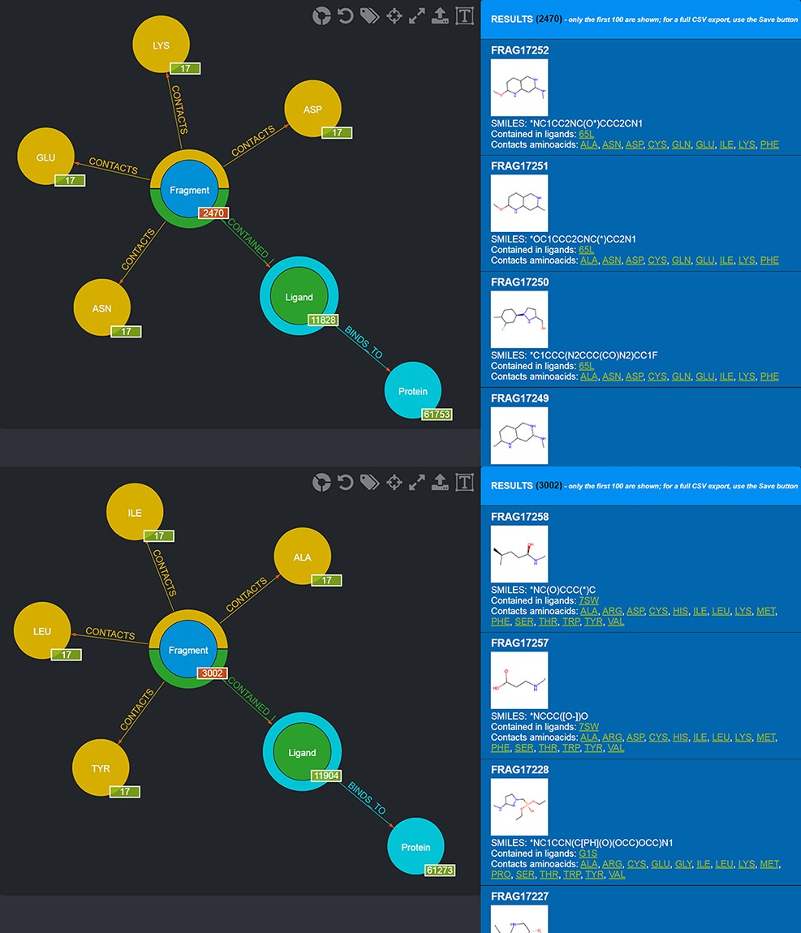
Figure 10. Screenshot of the graphical queries done to extract from the database those fragments discussed in the ...
Notes:
Figure 10. Screenshot of the graphical queries done to extract from the database those fragments discussed in the mesotrypsin use case, with, on the right side, a preview of the results of the queries.
Unless provided in the caption above, the following copyright applies to the content of this slide: © The Author(s) 2022. Published by Oxford University Press.This is an Open Access article distributed under the terms of the Creative Commons Attribution-NonCommercial License (https://creativecommons.org/licenses/by-nc/4.0/), which permits non-commercial re-use, distribution, and reproduction in any medium, provided the original work is properly cited. For commercial re-use, please contact journals.permissions@oup.com

