Slide 1
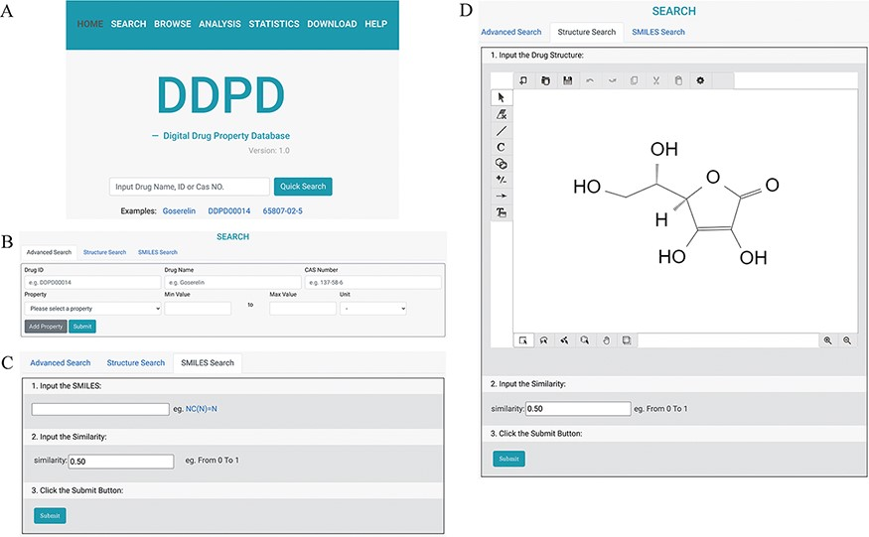
Figure 1. The search pages of DDPD: (A) On the home page, users can conduct simple search via drug name, DDPD ID or CAS ...
Notes:
Figure 1. The search pages of DDPD: (A) On the home page, users can conduct simple search via drug name, DDPD ID or CAS number. (B, C, D) On the search page, users can perform more advanced searches via one or more drug property values, SMILES or structure. (D) In Structure Search tab, users can draw chemical structures using the developed drawing tool.
Unless provided in the caption above, the following copyright applies to the content of this slide: © The Author(s) 2022. Published by Oxford University Press.This is an Open Access article distributed under the terms of the Creative Commons Attribution License (https://creativecommons.org/licenses/by/4.0/), which permits unrestricted reuse, distribution, and reproduction in any medium, provided the original work is properly cited.

