Slide 1
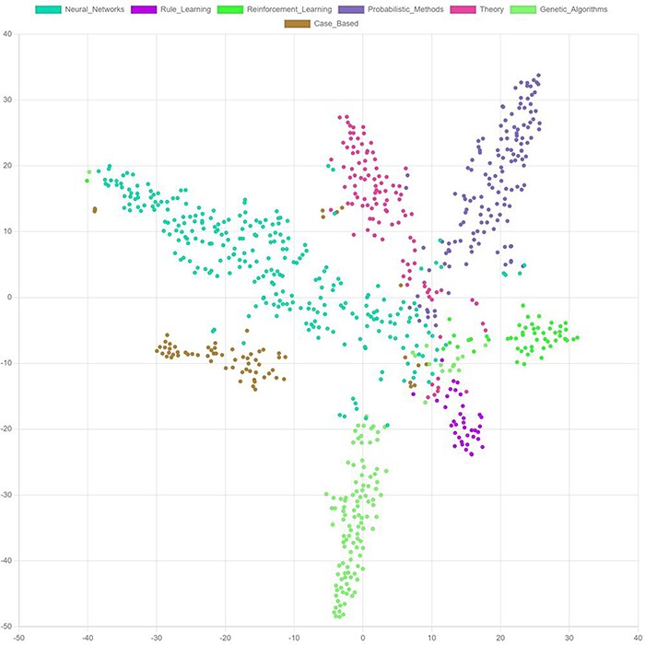
Figure 10. t-SNE. Visualization of final node embeddings after applying two graph convolutional layers on the Cora ...
Notes:
Figure 10. t-SNE. Visualization of final node embeddings after applying two graph convolutional layers on the Cora citation dataset (203) (PyTorch Geometric (204), embedding-dimension: 128). Each color represents a research topic for a node (circle).
Unless provided in the caption above, the following copyright applies to the content of this slide: © The Author(s) 2024. Published by Oxford University Press.This is an Open Access article distributed under the terms of the Creative Commons Attribution License (https://creativecommons.org/licenses/by/4.0/), which permits unrestricted reuse, distribution, and reproduction in any medium, provided the original work is properly cited.

