Slide 1
Figure 1. The CarrotOmics homepage includes (A) a news and events banner. (B) a Quick Start menu to directly access ...
Notes:
Figure 1. The CarrotOmics homepage includes (A) a news and events banner. (B) a Quick Start menu to directly access tools or data. (C) Pull-down menus to access all parts of the database. (D) A ‘Help’ pull-down menu to access user manuals and tutorials.
Unless provided in the caption above, the following copyright applies to the content of this slide: Published by Oxford University Press 2022. This work is written by (a) US Government employee(s) and is in the public domain in the US.This work is written by (a) US Government employee(s) and is in the public domain in the US.

Slide 2
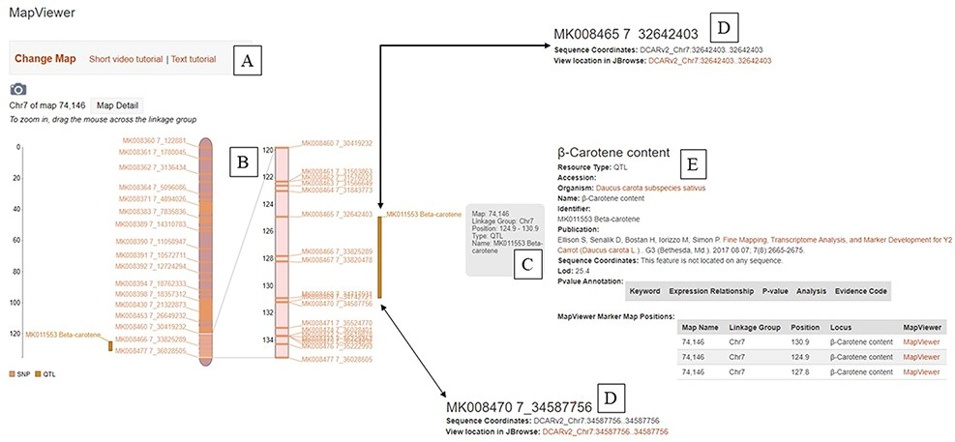
Figure 2. The ‘MapViewer’ tool available at CarrotOmics. (A) Links to video and text tutorials on use of ‘MapViewer’. ...
Notes:
Figure 2. The ‘MapViewer’ tool available at CarrotOmics. (A) Links to video and text tutorials on use of ‘MapViewer’. (B) Linkage map display from Y2 QTL mapping study. (C) Information about QTL displayed on interactive ‘MapViewer’ plot. (D) Physical positions for markers flanking Y2 locus. (E) Information about the study used to create the linkage map.
Unless provided in the caption above, the following copyright applies to the content of this slide: Published by Oxford University Press 2022. This work is written by (a) US Government employee(s) and is in the public domain in the US.This work is written by (a) US Government employee(s) and is in the public domain in the US.

Slide 3
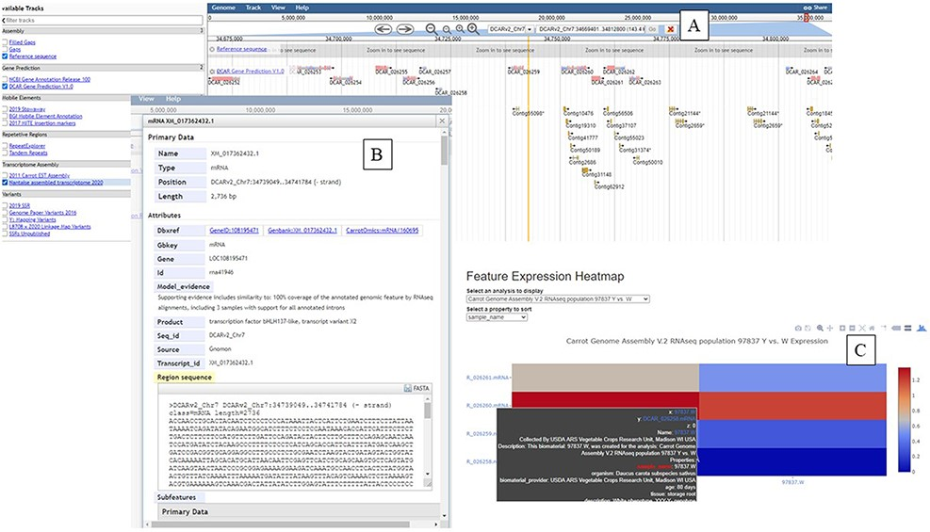
Figure 3. The ‘JBrowse’ tool available at CarrotOmics. (A) ‘JBrowse’ console with gene annotation tracks displayed. (B) ...
Notes:
Figure 3. The ‘JBrowse’ tool available at CarrotOmics. (A) ‘JBrowse’ console with gene annotation tracks displayed. (B) Information about selected gene. (C) Heatmap display from transcriptome studies available from ‘Expression Heatmap’ tool.
Unless provided in the caption above, the following copyright applies to the content of this slide: Published by Oxford University Press 2022. This work is written by (a) US Government employee(s) and is in the public domain in the US.This work is written by (a) US Government employee(s) and is in the public domain in the US.

