Slide 1
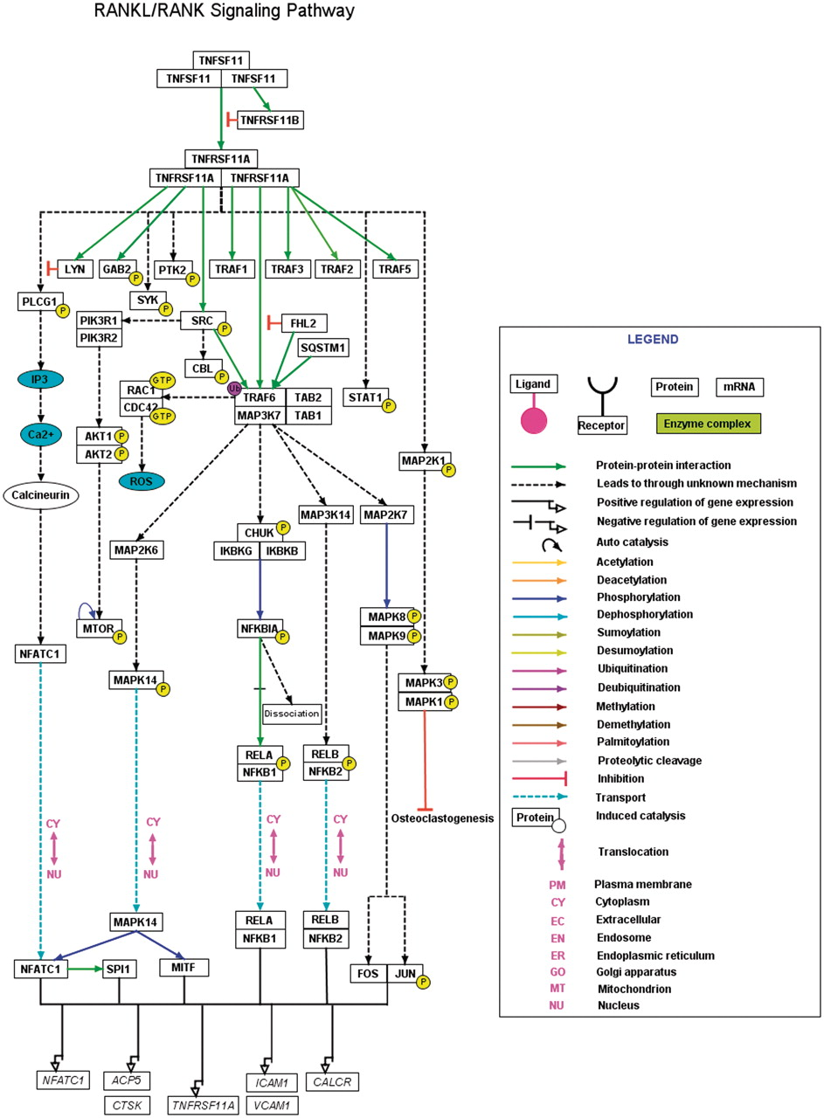
Figure 2. A high-confidence RANKL/RANK pathway reaction map using PathVisio. The RANKL/RANK pathway reaction map ...
Notes:
Figure 2. A high-confidence RANKL/RANK pathway reaction map using PathVisio. The RANKL/RANK pathway reaction map represents the high-confidence molecular reactions induced by the binding of RANKL homotrimer to its homotrimer receptor complex. The presented map of RANKL/RANK contains 43 proteins involved in 17 molecular associations, 24 enzyme catalysis reactions and four translocation events. The nodes and edges represent the molecules and their reactions respectively. A detailed legend representative of the information of different types of edges distinguished with various colors is provided. A downloadable version of this map is available with the description for each of the reactions and the inclusion criteria for selection of the reaction in the map at http://www.netpath.org/netslim/rankl_pathway.html.
Unless provided in the caption above, the following copyright applies to the content of this slide: © The Author(s) 2011. Published by Oxford University Press.This is Open Access article distributed under the terms of the Creative Commons Attribution Non-Commercial License (http://creativecommons.org/licenses/by-nc/2.5), which permits unrestricted non-commercial use, distribution, and reproduction in any medium, provided the original work is properly cited.

