Slide 1
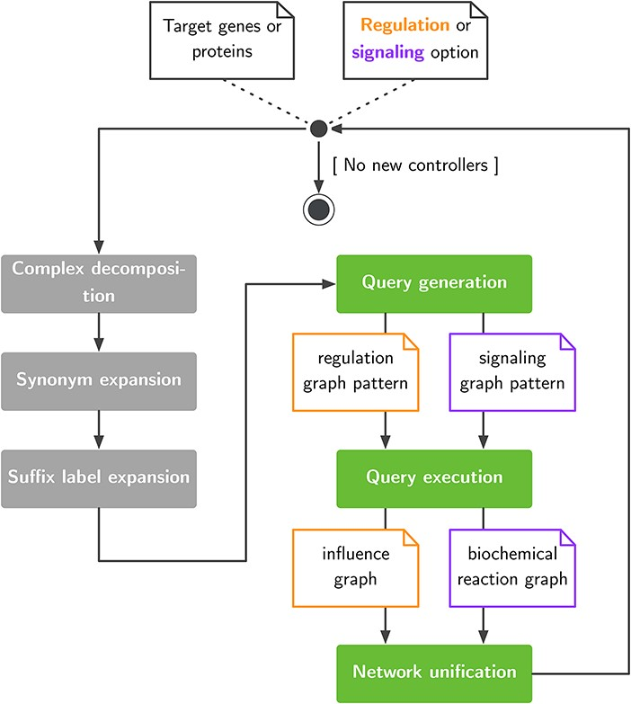
Figure 1. Exploration of large pathway databases to assemble gene regulatory and signaling networks.
Notes:
Figure 1. Exploration of large pathway databases to assemble gene regulatory and signaling networks.
Unless provided in the caption above, the following copyright applies to the content of this slide: © The Author(s) 2021. Published by Oxford University Press.This is an Open Access article distributed under the terms of the Creative Commons Attribution License (http://creativecommons.org/licenses/by/4.0/), which permits unrestricted reuse, distribution, and reproduction in any medium, provided the original work is properly cited.

Slide 2
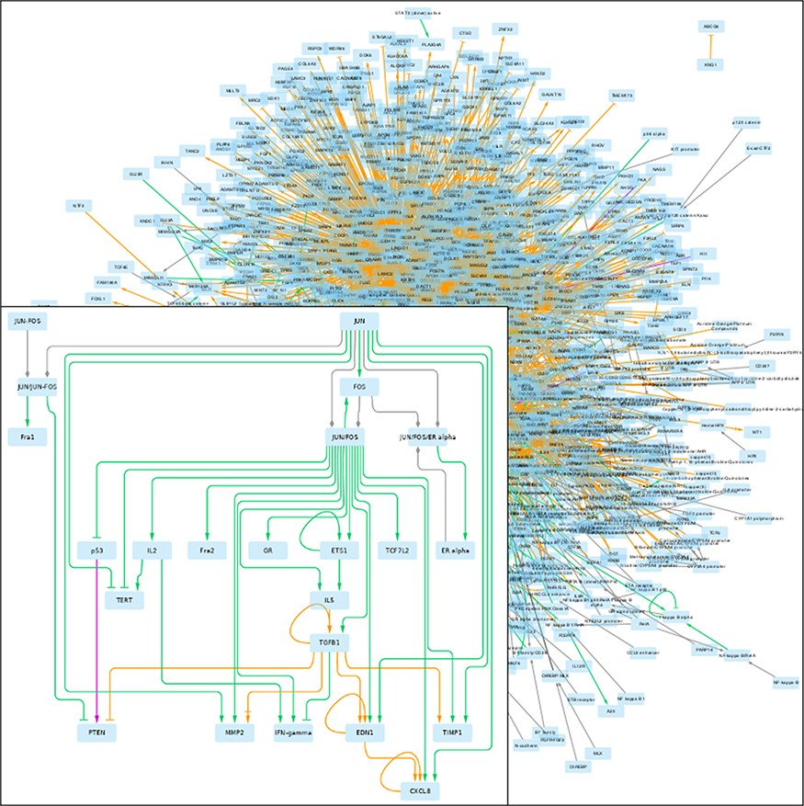
Figure 2. GRN returned by pyBRAvo. The color code of the edges gives their provenance: orange for CTD, purple for ...
Notes:
Figure 2. GRN returned by pyBRAvo. The color code of the edges gives their provenance: orange for CTD, purple for Panther, green for PID, red for Reactome and gray for the expansion of protein complexes. The edge tips depend on the interactions type: triangle for an activation, bar for an inhibition, arrow with bar for an unknown interaction type and diamond for a complex composition. This graphical export was made with Cytoscape 3.7 (13), following the instructions of Supplementary Methods G.
Unless provided in the caption above, the following copyright applies to the content of this slide: © The Author(s) 2021. Published by Oxford University Press.This is an Open Access article distributed under the terms of the Creative Commons Attribution License (http://creativecommons.org/licenses/by/4.0/), which permits unrestricted reuse, distribution, and reproduction in any medium, provided the original work is properly cited.

Slide 3
Figure 4. Betweenness centrality vs. number of neighbor nodes for the largest component graph obtained with PyPath and ...
Notes:
Figure 4. Betweenness centrality vs. number of neighbor nodes for the largest component graph obtained with PyPath and pyBRAvo, respectively, when querying signaling knowledge in Omnipath and PC. The names of the 10 species having the highest betweenness centrality score are shown, and blue names and blue stars correspond to species top-ranked in both graphs.
Unless provided in the caption above, the following copyright applies to the content of this slide: © The Author(s) 2021. Published by Oxford University Press.This is an Open Access article distributed under the terms of the Creative Commons Attribution License (http://creativecommons.org/licenses/by/4.0/), which permits unrestricted reuse, distribution, and reproduction in any medium, provided the original work is properly cited.

Slide 4
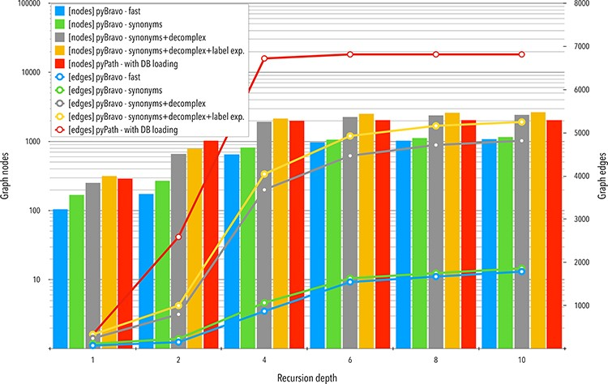
Figure 3. Comparative analyses of the networks obtained with pyBRAvo and PyPath. The horizontal axis represents the ...
Notes:
Figure 3. Comparative analyses of the networks obtained with pyBRAvo and PyPath. The horizontal axis represents the level of reconstruction depth of the SN. Bars plot show measures of the number of nodes; lines show the number of edges, the y-axis (left) is shown in a logarithmic scale.
Unless provided in the caption above, the following copyright applies to the content of this slide: © The Author(s) 2021. Published by Oxford University Press.This is an Open Access article distributed under the terms of the Creative Commons Attribution License (http://creativecommons.org/licenses/by/4.0/), which permits unrestricted reuse, distribution, and reproduction in any medium, provided the original work is properly cited.

