Slide 1
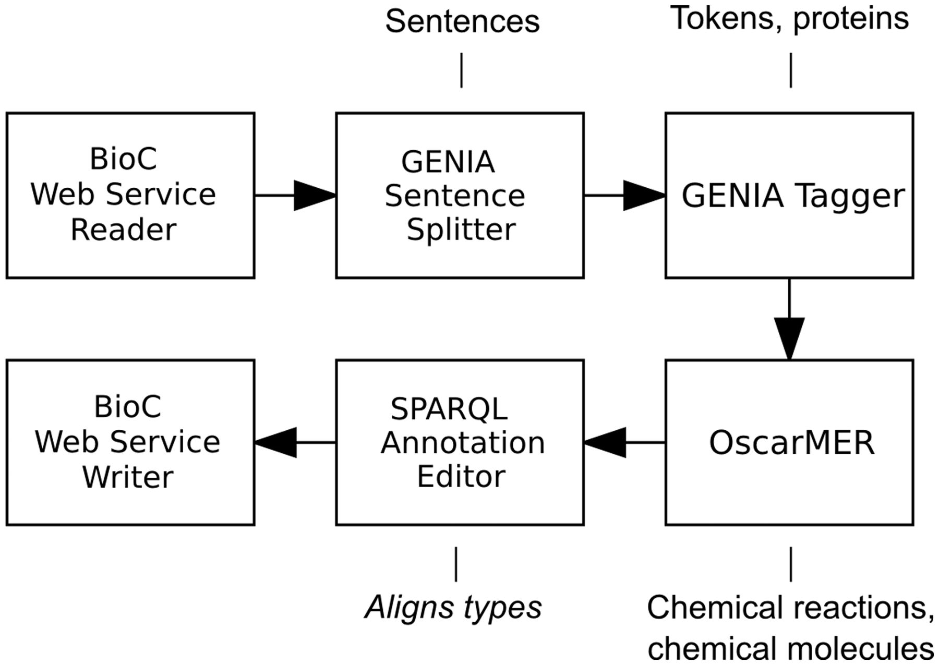
Figure 1. A Web service-enabled workflow built in Argo for identification of metabolic process concepts. The workflow ...
Notes:
Figure 1. A Web service-enabled workflow built in Argo for identification of metabolic process concepts. The workflow features BioC as the Web service’s input and output format. The callouts show component-specific output annotation types that are relevant for this workflow.
Unless provided in the caption above, the following copyright applies to the content of this slide: © The Author(s) 2014. Published by Oxford University Press.This is an Open Access article distributed under the terms of the Creative Commons Attribution License (http://creativecommons.org/licenses/by/3.0/), which permits unrestricted reuse, distribution, and reproduction in any medium, provided the original work is properly cited.

Slide 2
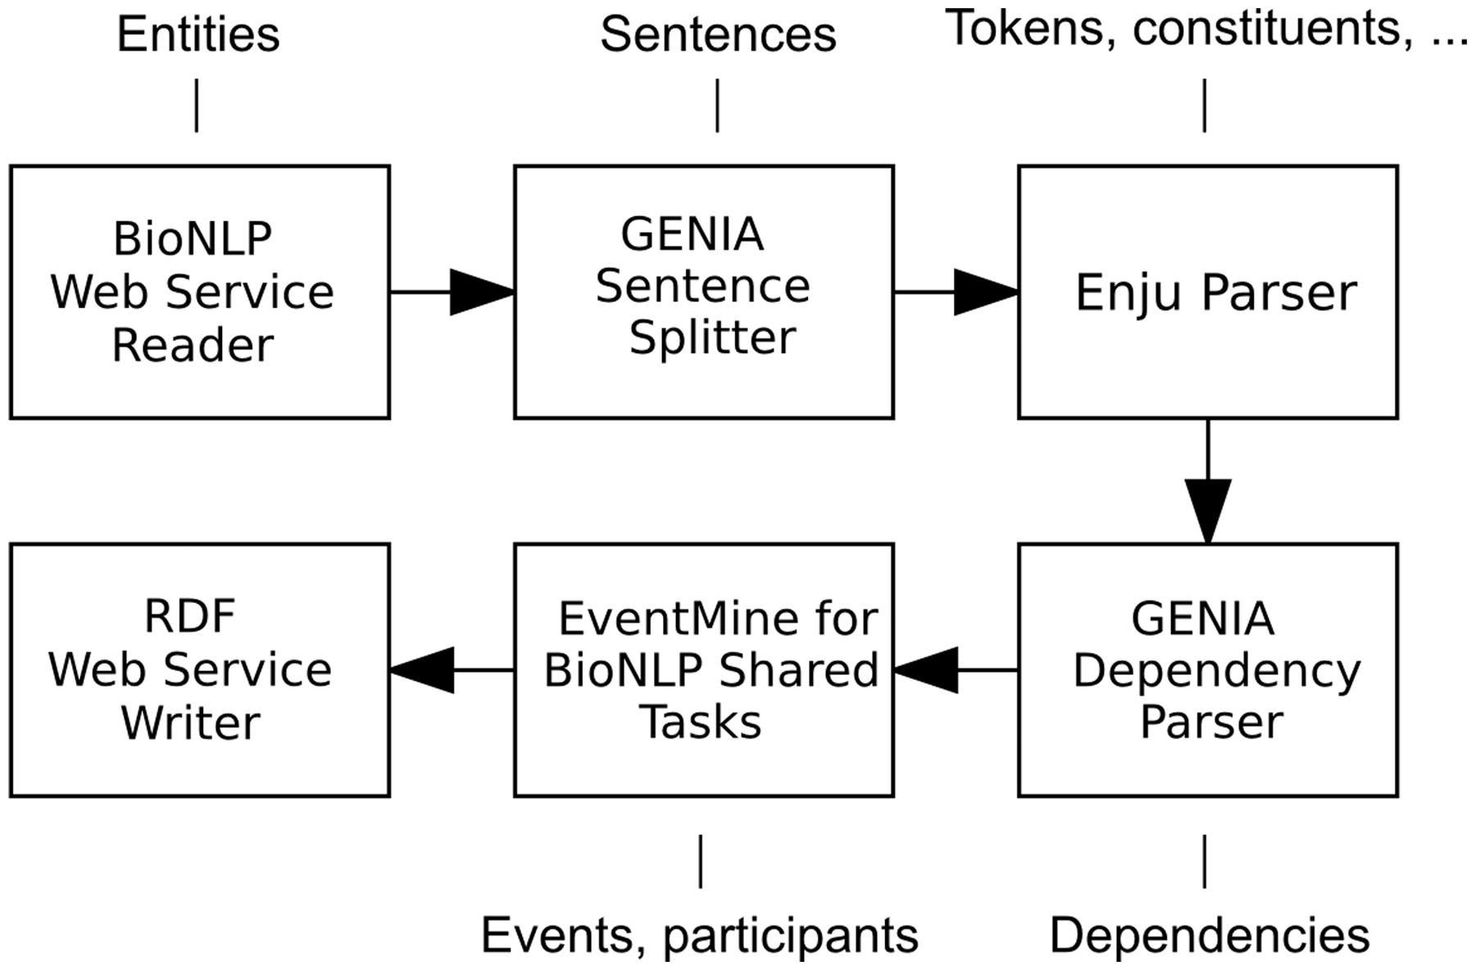
Figure 2. A Web service-enabled workflow built in Argo for biological event extraction. The workflow accepts REST calls ...
Notes:
Figure 2. A Web service-enabled workflow built in Argo for biological event extraction. The workflow accepts REST calls with data in BioNLP format and produces RDF output. The callouts show component-specific output annotation types that are relevant for this workflow.
Unless provided in the caption above, the following copyright applies to the content of this slide: © The Author(s) 2014. Published by Oxford University Press.This is an Open Access article distributed under the terms of the Creative Commons Attribution License (http://creativecommons.org/licenses/by/3.0/), which permits unrestricted reuse, distribution, and reproduction in any medium, provided the original work is properly cited.

