Slide 1
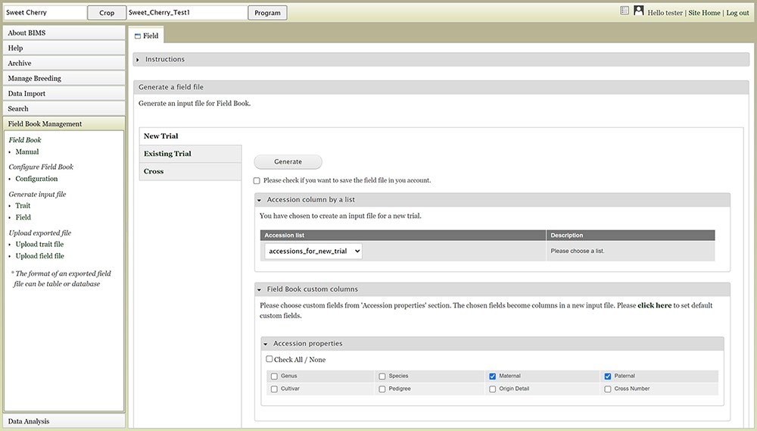
Figure 16. BIMS interface where users can create input files for the Field Book App.
Notes:
Figure 16. BIMS interface where users can create input files for the Field Book App.
Unless provided in the caption above, the following copyright applies to the content of this slide: © The Author(s) 2021. Published by Oxford University Press.This is an Open Access article distributed under the terms of the Creative Commons Attribution License (http://creativecommons.org/licenses/by/4.0/), which permits unrestricted reuse, distribution, and reproduction in any medium, provided the original work is properly cited.

