Slide 1
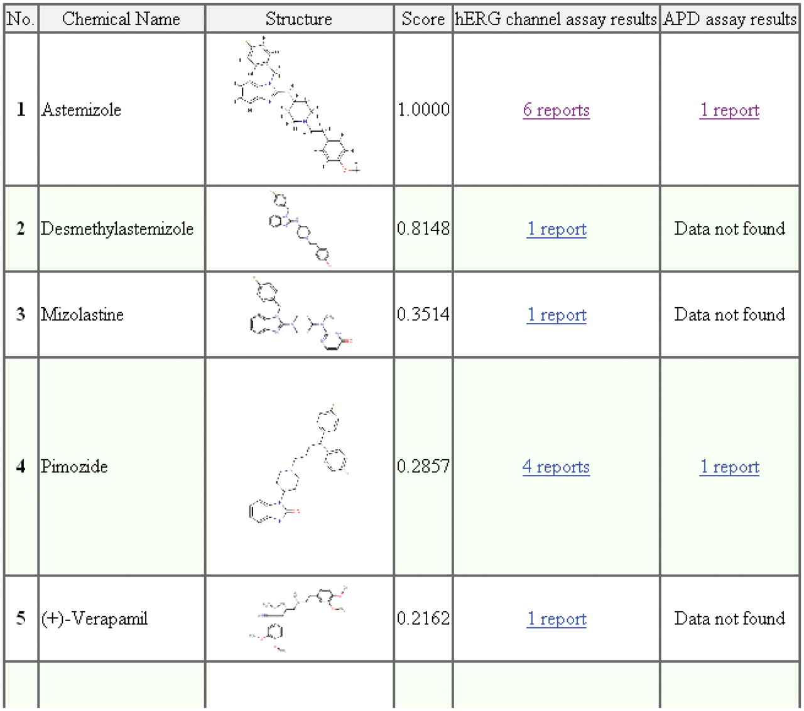
Figure 4. Screen capture of the similarity search results for astemizole. The attributes listed in the results table, ...
Notes:
Figure 4. Screen capture of the similarity search results for astemizole. The attributes listed in the results table, i.e. No., chemical name, structure, score, hERG channel assay results and APD assay results, indicate the compound's similarity rank among the top 30 compounds, the name of the chemical compounds, JPG images of the chemical compounds, the similarity score calculated by tanimoto.pl, hERG assay results and the APD assay results, respectively.
Unless provided in the caption above, the following copyright applies to the content of this slide: © The Author(s) 2011. Published by Oxford University Press.This is Open Access article distributed under the terms of the Creative Commons Attribution Non-Commercial License (http://creativecommons.org/licenses/by-nc/2.5), which permits unrestricted non-commercial use, distribution, and reproduction in any medium, provided the original work is properly cited.

