Slide 1
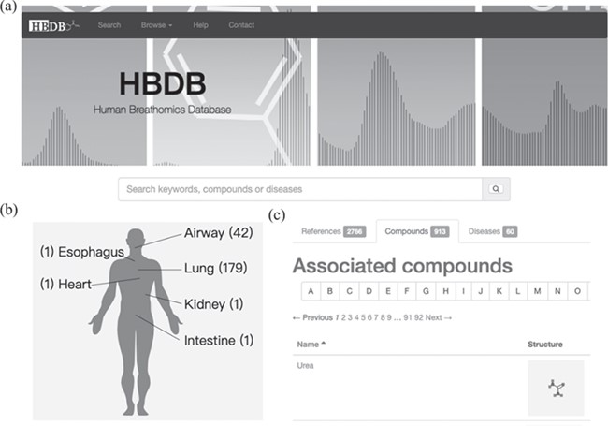
Figure 1 User interface and visualization of disease mapping. (a) Browse and search interface of the HBDB. (b) Disease ...
Notes:
Figure 1 User interface and visualization of disease mapping. (a) Browse and search interface of the HBDB. (b) Disease mapping to human physiology and statistics of references associated with diseases. (c) The collected compounds, references and diseases are listed in three tabs for browsing.
Unless provided in the caption above, the following copyright applies to the content of this slide: © The Author(s) 2020. Published by Oxford University Press.This is an Open Access article distributed under the terms of the Creative Commons Attribution License (http://creativecommons.org/licenses/by/4.0/), which permits unrestricted reuse, distribution, and reproduction in any medium, provided the original work is properly cited.

