Slide 1
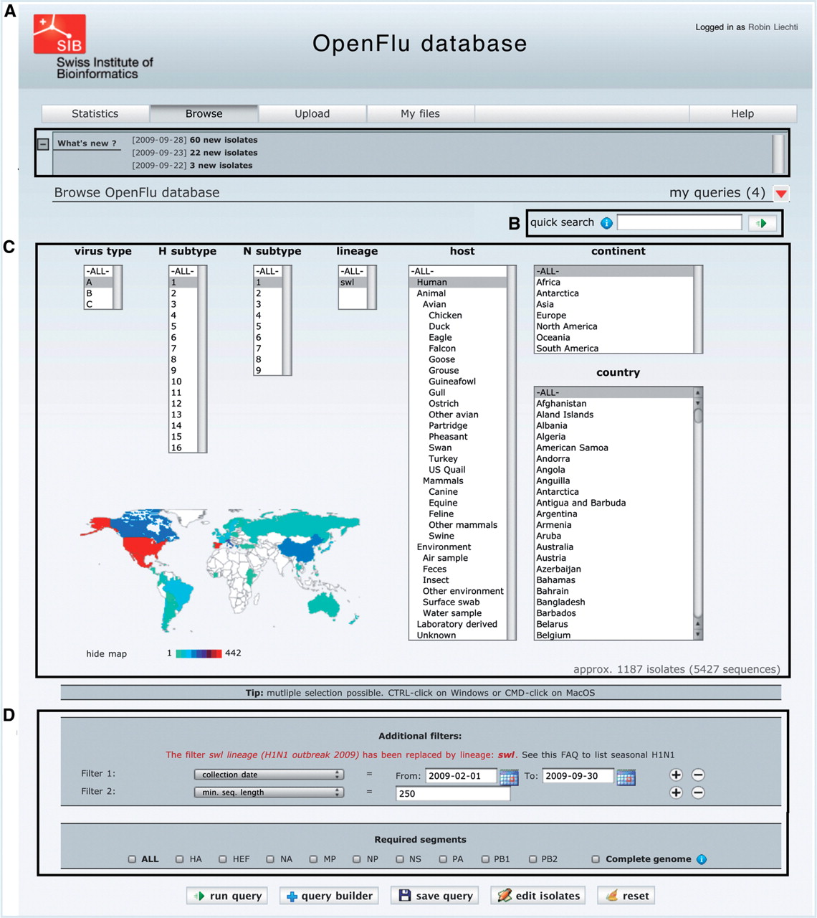
Figure 2. The ‘browse’ form is the major entry point to query the database. (A) ‘What’s new’ section contains links to ...
Notes:
Figure 2. The ‘browse’ form is the major entry point to query the database. (A) ‘What’s new’ section contains links to newly deposited sequences and announcements about OpenFluDB feature development. (B) The ‘Quick search’ field is used to query on EPI_ISL_ID, EPIID, isolate name or EMBL/DDBJ/GenBank accession numbers. (C) Basic ‘browse’ fields are composed of viral type and subtype, viral host and sample collection geographical location. Multiple selections are possible. (D) Several additional filters can be appended to the query; sample collection date, submission date, minimal sequence length, isolate name, EPI_ISL_ID, passage history, lineage, EPIID, DDBJ/EMBL/GenBank accession number, sequence submitter laboratory, whether the isolate has been primarily deposited in OpenFluDB, whether the isolate is publicly accessible in DDBJ/EMBL/GenBank and whether the sequence has a complete CDS. Finally, required segments or complete genome can be specified.
Unless provided in the caption above, the following copyright applies to the content of this slide: © The Author(s) 2010. Published by Oxford University Press.This is Open Access article distributed under the terms of the Creative Commons Attribution Non-Commercial License (http://creativecommons.org/licenses/by-nc/2.5), which permits unrestricted non-commercial use, distribution, and reproduction in any medium, provided the original work is properly cited.

