Slide 1
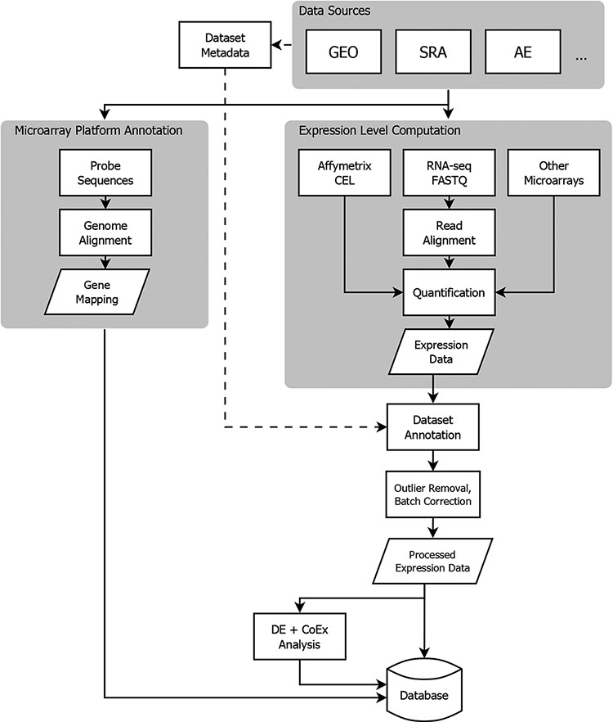
Figure 1. Flowchart showing the flow of data from NCBI GEO into the Gemma database. Three classes of information are ...
Notes:
Figure 1. Flowchart showing the flow of data from NCBI GEO into the Gemma database. Three classes of information are processed: platform metadata, gene expression data and metadata. While microarray data reside on GEO, raw RNA-sequencing (RNA-seq) data are obtained from NCBI Sequence Read Archive (SRA). AE: ArrayExpress, DE: differential expression, and CoEx: co-expression.
Unless provided in the caption above, the following copyright applies to the content of this slide: © The Author(s) 2021. Published by Oxford University Press.This is an Open Access article distributed under the terms of the Creative Commons Attribution License (http://creativecommons.org/licenses/by/4.0/), which permits unrestricted reuse, distribution, and reproduction in any medium, provided the original work is properly cited.

