Slide 1
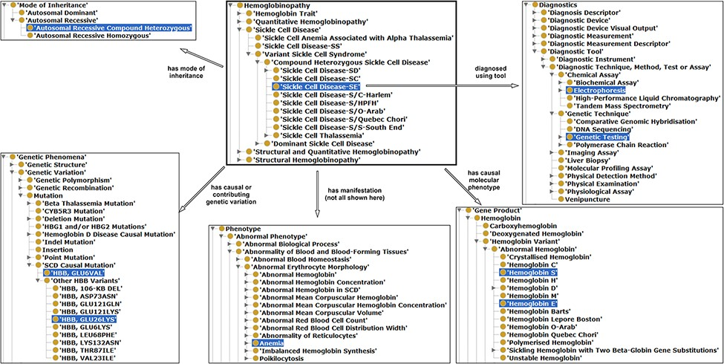
Figure 3. Illustration of properties between hemoglobinopathy concepts as an approach to integrating existing ...
Notes:
Figure 3. Illustration of properties between hemoglobinopathy concepts as an approach to integrating existing hemoglobinopathy knowledge. The ‘Sickle Cell Disease-SE’ class is the reference or the object, a subclass of hemoglobinopathy having some properties (annotation in different arrows) related with other classes (subjects) highlighted in blue.
Unless provided in the caption above, the following copyright applies to the content of this slide: © The Author(s) 2022. Published by Oxford University Press.This is an Open Access article distributed under the terms of the Creative Commons Attribution License (https://creativecommons.org/licenses/by/4.0/), which permits unrestricted reuse, distribution, and reproduction in any medium, provided the original work is properly cited.

