Slide 1
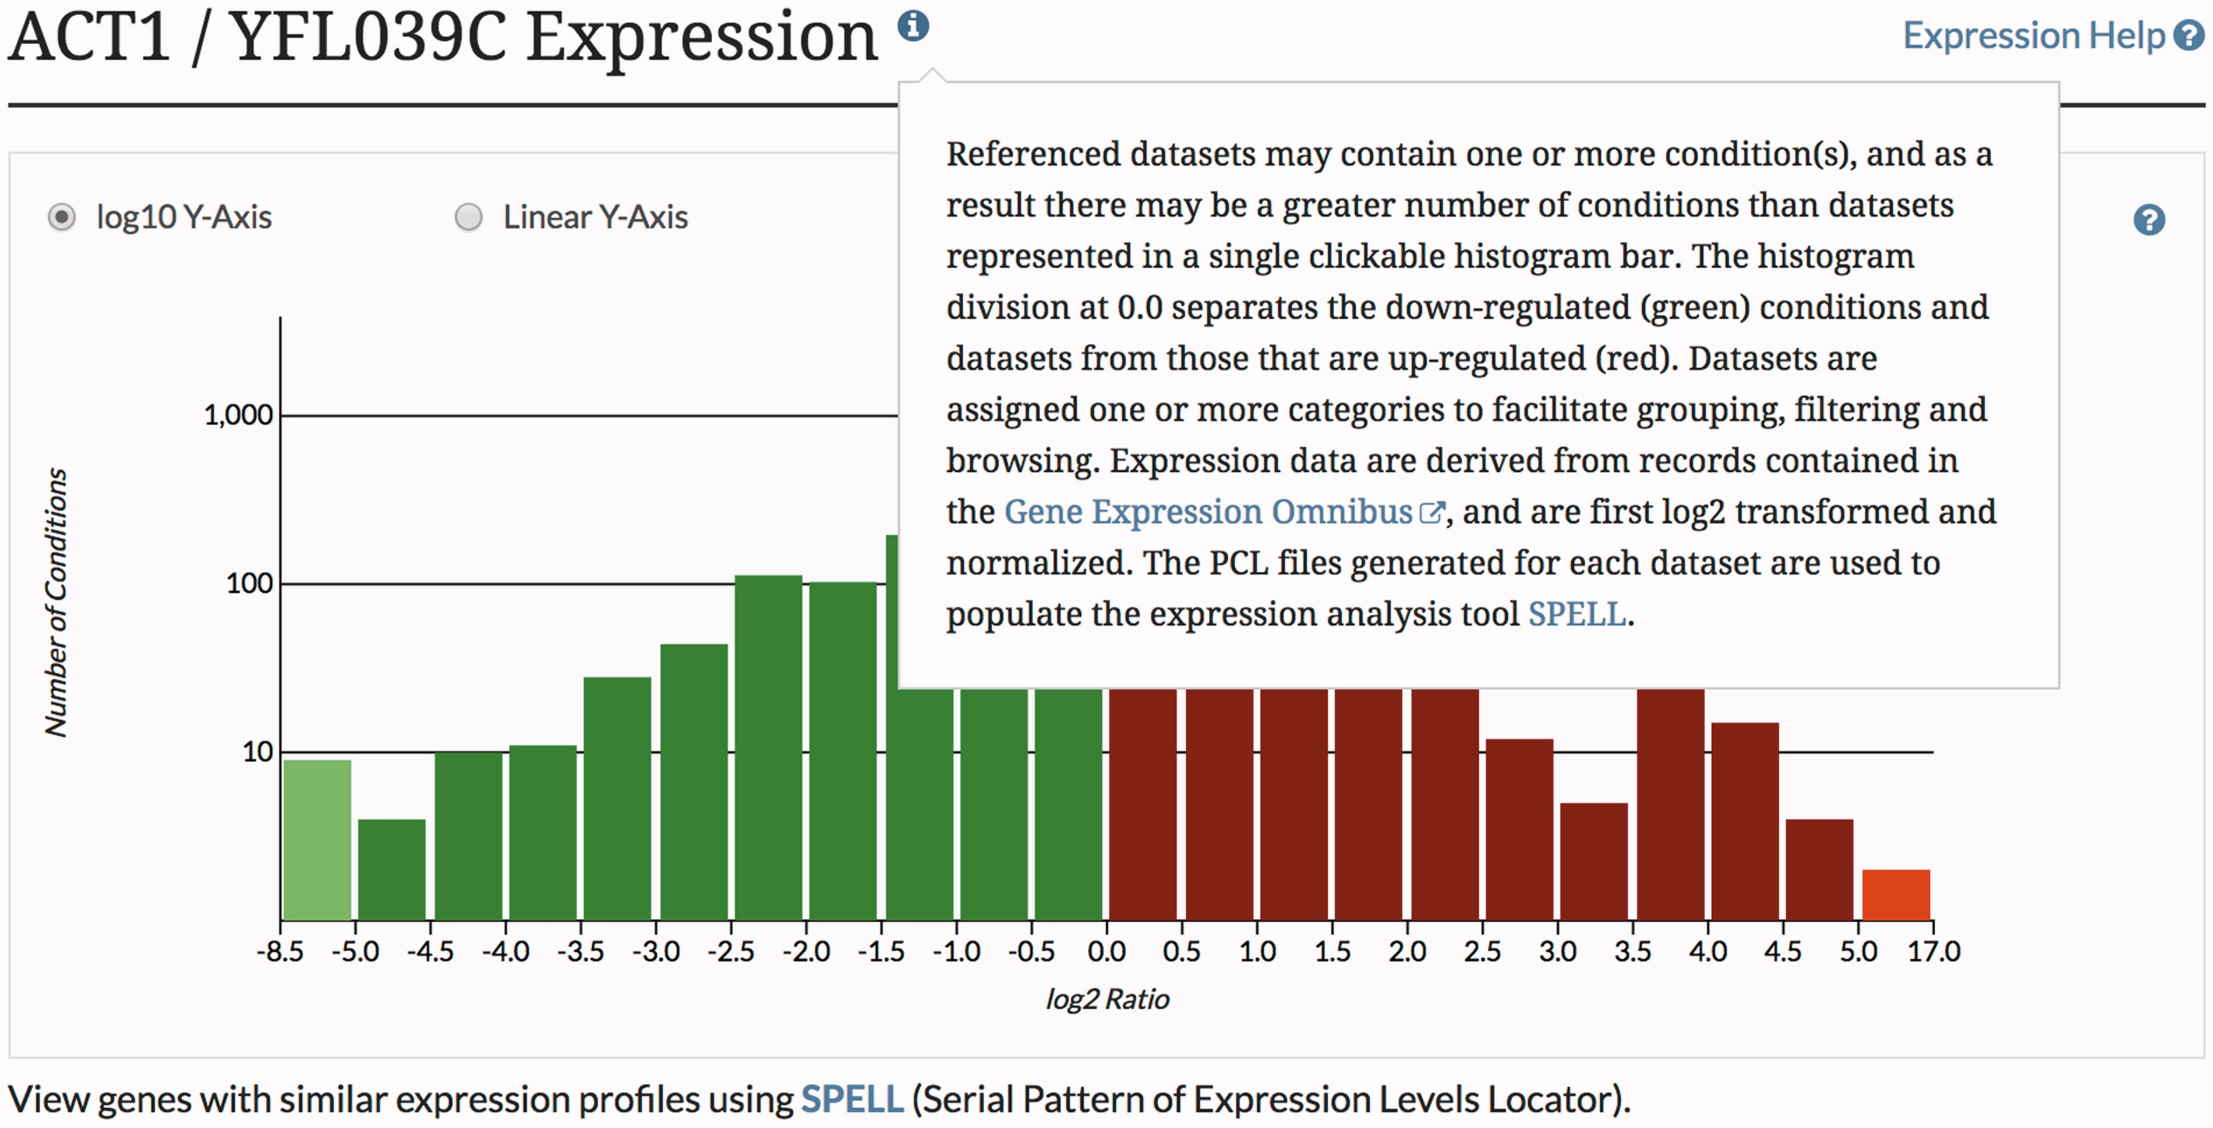
Figure 3 The SGD provides context-specific help throughout the SGD website, enabling quick in situ access to ...
Notes:
Figure 3 The SGD provides context-specific help throughout the SGD website, enabling quick in situ access to explanations of various tools and features.
Unless provided in the caption above, the following copyright applies to the content of this slide: © The Author(s) 2017. Published by Oxford University Press.This is an Open Access article distributed under the terms of the Creative Commons Attribution License (http://creativecommons.org/licenses/by/4.0/), which permits unrestricted reuse, distribution, and reproduction in any medium, provided the original work is properly cited.

