Slide 1
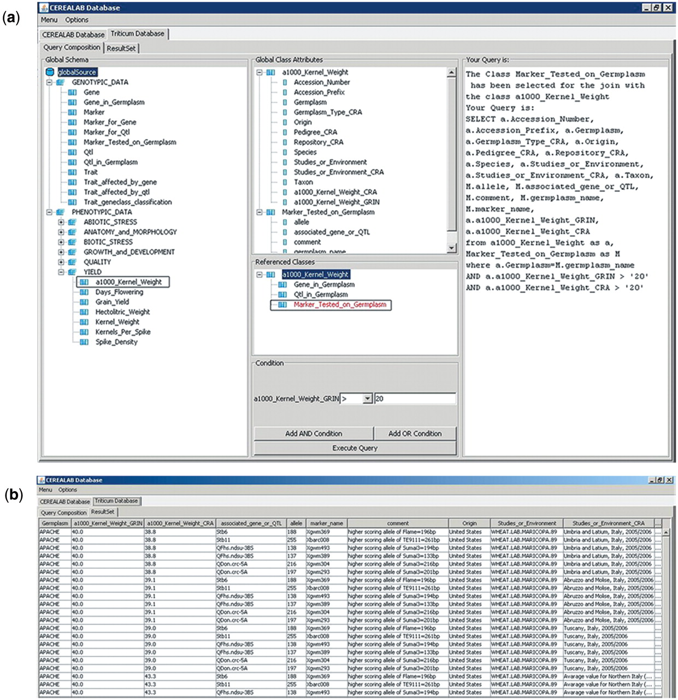
Figure 2. Screenshots of the query example (a) and of the results (b) returning information about wheat varieties ...
Notes:
Figure 2. Screenshots of the query example (a) and of the results (b) returning information about wheat varieties characterized by 1000 kernel weight value >20 g and genotyped with molecular markers associated with genes and QTLs for resistance to major pathogens.
Unless provided in the caption above, the following copyright applies to the content of this slide: © The Author(s) 2011. Published by Oxford University Press.This is Open Access article distributed under the terms of the Creative Commons Attribution Non-Commercial License (http://creativecommons.org/licenses/by-nc/2.5), which permits unrestricted non-commercial use, distribution, and reproduction in any medium, provided the original work is properly cited.

