Slide 1
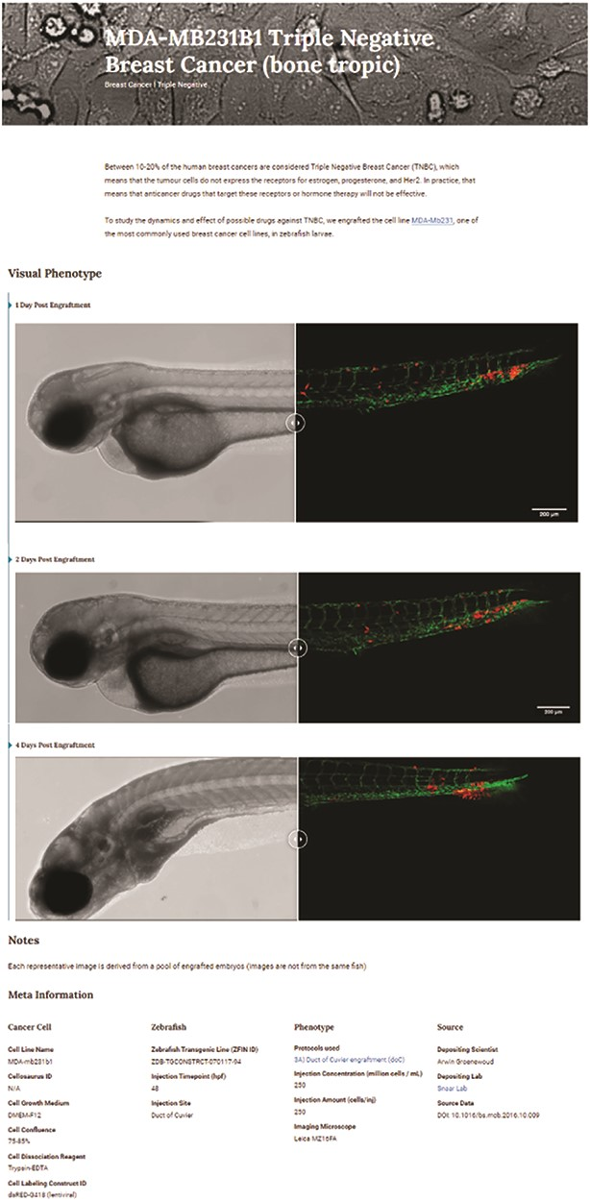
Figure 3. Triple-negative breast cancer sample data as deposited. Image-based analysis data are used to generate a ...
Notes:
Figure 3. Triple-negative breast cancer sample data as deposited. Image-based analysis data are used to generate a graph for the original publication and are subsequently uploaded to XePHIR (either directly or indirectly). Subsequently, the available metadata is entered during submission (filling in the available data in the submission template). All metadata will be displayed next to the images that have been uploaded, when uploaded via Zenodo a DOI will be provided to allow easy access to the original data set.
Unless provided in the caption above, the following copyright applies to the content of this slide: © The Author(s) 2022. Published by Oxford University Press.This is an Open Access article distributed under the terms of the Creative Commons Attribution-NonCommercial License (https://creativecommons.org/licenses/by-nc/4.0/), which permits non-commercial re-use, distribution, and reproduction in any medium, provided the original work is properly cited. For commercial re-use, please contact journals.permissions@oup.com

