Slide 1
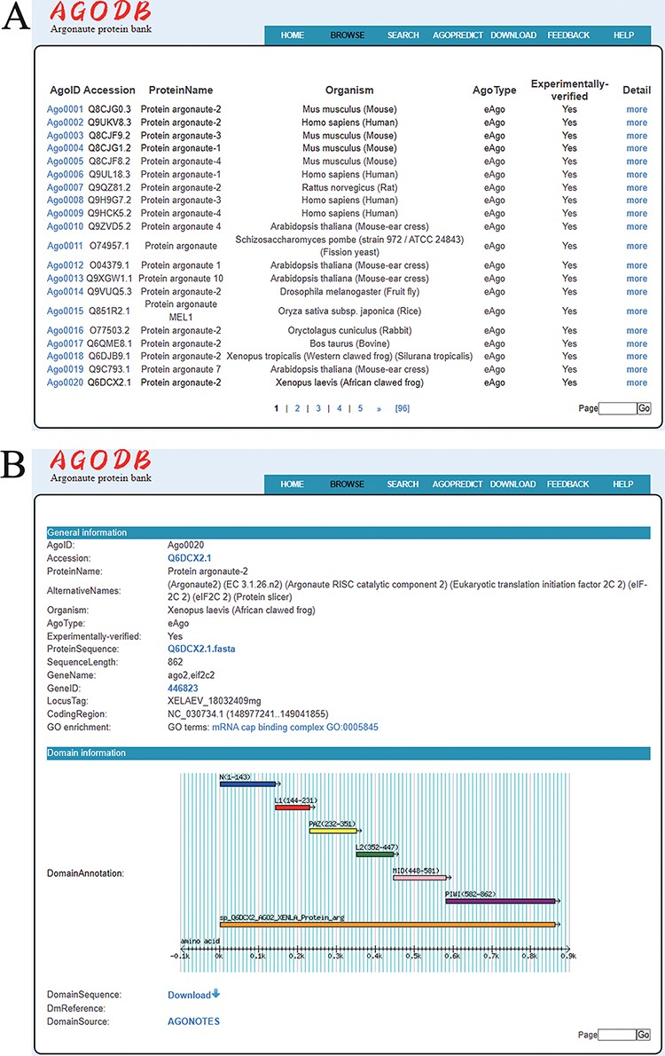
Figure 4. Browsing page of AGODB. (A) A brief browsing table displays fields, including AgoID, Accession, ProteinName, ...
Notes:
Figure 4. Browsing page of AGODB. (A) A brief browsing table displays fields, including AgoID, Accession, ProteinName, Organism, AgoType, Experimentally verified and links directing to the ‘Detail’ page. (B) The ‘Detail’ page shows detailed descriptions of each Ago protein.
Unless provided in the caption above, the following copyright applies to the content of this slide: © The Author(s) 2022. Published by Oxford University Press.This is an Open Access article distributed under the terms of the Creative Commons Attribution-NonCommercial License (https://creativecommons.org/licenses/by-nc/4.0/), which permits non-commercial re-use, distribution, and reproduction in any medium, provided the original work is properly cited. For commercial re-use, please contact journals.permissions@oup.com

