Slide 1
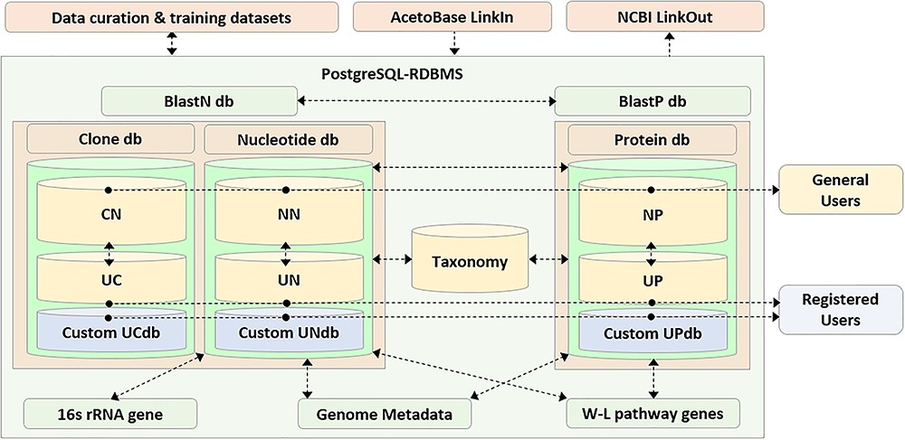
Figure 1 Schematic representation of the AcetoBase repository and database. The nucleotide database (db) table ...
Notes:
Figure 1 Schematic representation of the AcetoBase repository and database. The nucleotide database (db) table consists of reference nucleotide (NN) table and user nucleotide (UN) table, the clone database table consists of reference clone (CN) table and user clone (UC) table and the protein database table consists of reference protein (NP) table and user protein (UP) table. General users have access to all sequences in the databases except for those that are not yet public, while registered users also have access to the custom database generated with their own clone (UCdb), nucleotide (UNdb) and protein (UPdb) sequences. W-L, Wood–Ljungdahl.
Unless provided in the caption above, the following copyright applies to the content of this slide: © The Author(s) 2019. Published by Oxford University Press.This is an Open Access article distributed under the terms of the Creative Commons Attribution Non-Commercial License (http://creativecommons.org/licenses/by-nc/4.0/), which permits non-commercial re-use, distribution, and reproduction in any medium, provided the original work is properly cited. For commercial re-use, please contact journals.permissions@oup.com

