Slide 1
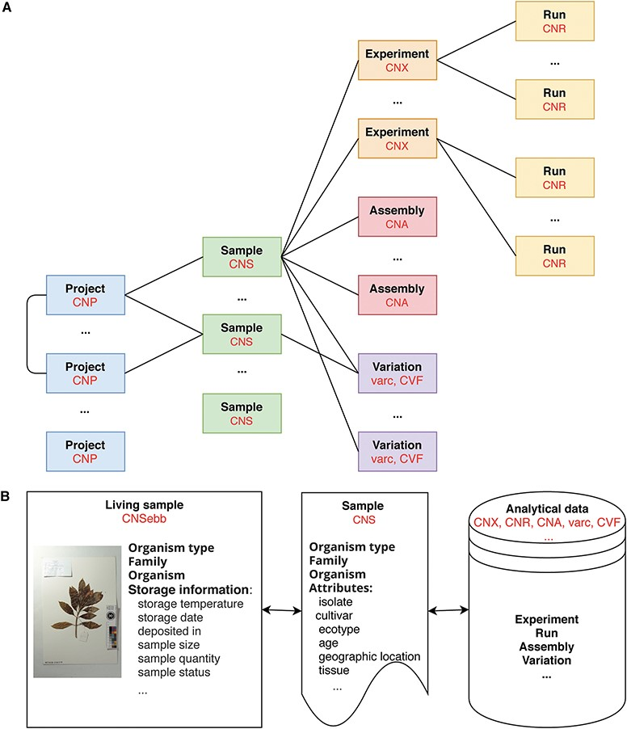
Figure 1 Data model in CNSA A. At present, CNSA has six data objects, and the corresponding prefixes of accession ...
Notes:
Figure 1 Data model in CNSA A. At present, CNSA has six data objects, and the corresponding prefixes of accession numbers are marked in red. B. Correlation model for Ruili Botanical Garden project.
Unless provided in the caption above, the following copyright applies to the content of this slide: © The Author(s) 2020. Published by Oxford University Press.This is an Open Access article distributed under the terms of the Creative Commons Attribution License (http://creativecommons.org/licenses/by/4.0/), which permits unrestricted reuse, distribution, and reproduction in any medium, provided the original work is properly cited.

Slide 2
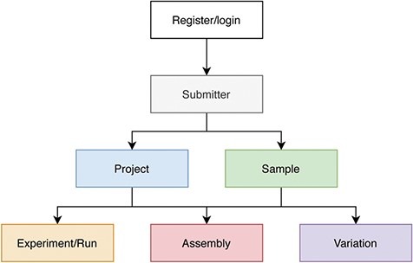
Figure 2 Process of data submission to CNSA.
Notes:
Figure 2 Process of data submission to CNSA.
Unless provided in the caption above, the following copyright applies to the content of this slide: © The Author(s) 2020. Published by Oxford University Press.This is an Open Access article distributed under the terms of the Creative Commons Attribution License (http://creativecommons.org/licenses/by/4.0/), which permits unrestricted reuse, distribution, and reproduction in any medium, provided the original work is properly cited.

Slide 3
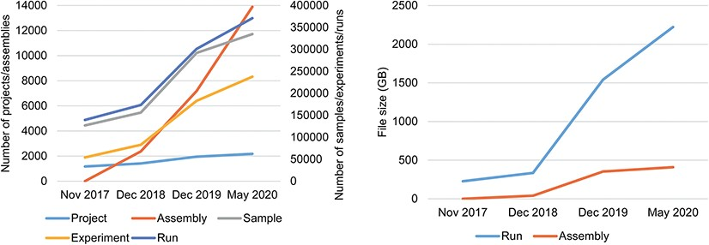
Figure 3 Data statistics of CNSA A. Numbers of Projects, Samples, Assemblies, Experiments and runs in CNSA. B. File ...
Notes:
Figure 3 Data statistics of CNSA A. Numbers of Projects, Samples, Assemblies, Experiments and runs in CNSA. B. File sizes of Runs and Assemblies in CNSA. All statistics are based on data submitted from November 2017 to May 2020.
Unless provided in the caption above, the following copyright applies to the content of this slide: © The Author(s) 2020. Published by Oxford University Press.This is an Open Access article distributed under the terms of the Creative Commons Attribution License (http://creativecommons.org/licenses/by/4.0/), which permits unrestricted reuse, distribution, and reproduction in any medium, provided the original work is properly cited.

