Slide 1
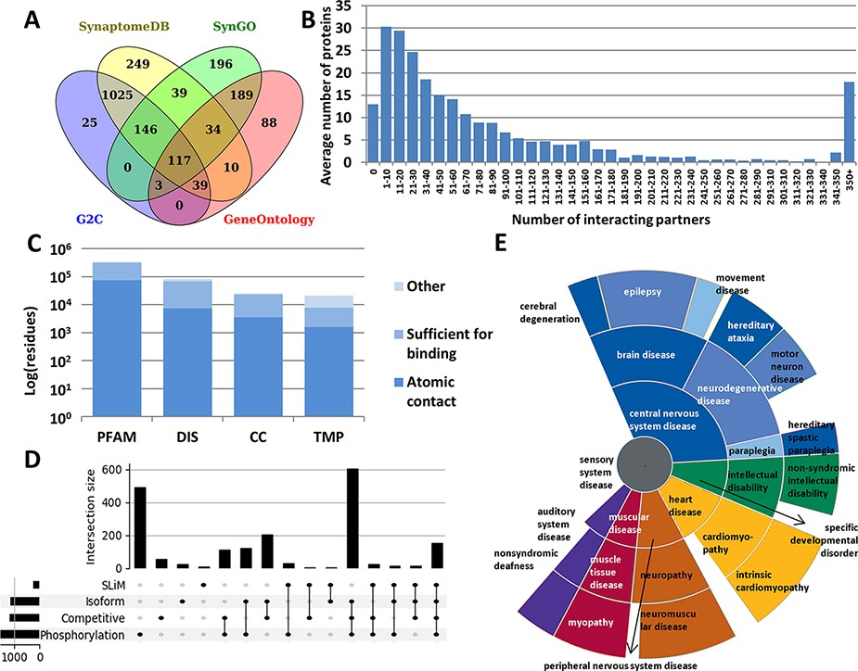
Figure 1. Summary statistics of PSINDB database: (A) Number of postsynaptic proteins from each source database and ...
Notes:
Figure 1. Summary statistics of PSINDB database: (A) Number of postsynaptic proteins from each source database and their overlaps. (B) Distribution of interacting partners of postsynaptic proteins. (C) Ratio of residues in different structural binding regions, colored by the level of information available about the binding residue (PFAM: belonging to protein families identified by Pfam; DIS: Disordered; CC: Coiled-coil; TMP: Transmembrane Protein). (D) Distribution of regulatory mechanisms in PS proteins (SLiM: Short Linear Motif). (E) Distribution of diseases associated with PS proteins. The more general the term, the closer it is to the center.
Unless provided in the caption above, the following copyright applies to the content of this slide: © The Author(s) 2022. Published by Oxford University Press.This is an Open Access article distributed under the terms of the Creative Commons Attribution License (https://creativecommons.org/licenses/by/4.0/), which permits unrestricted reuse, distribution, and reproduction in any medium, provided the original work is properly cited.

Slide 2
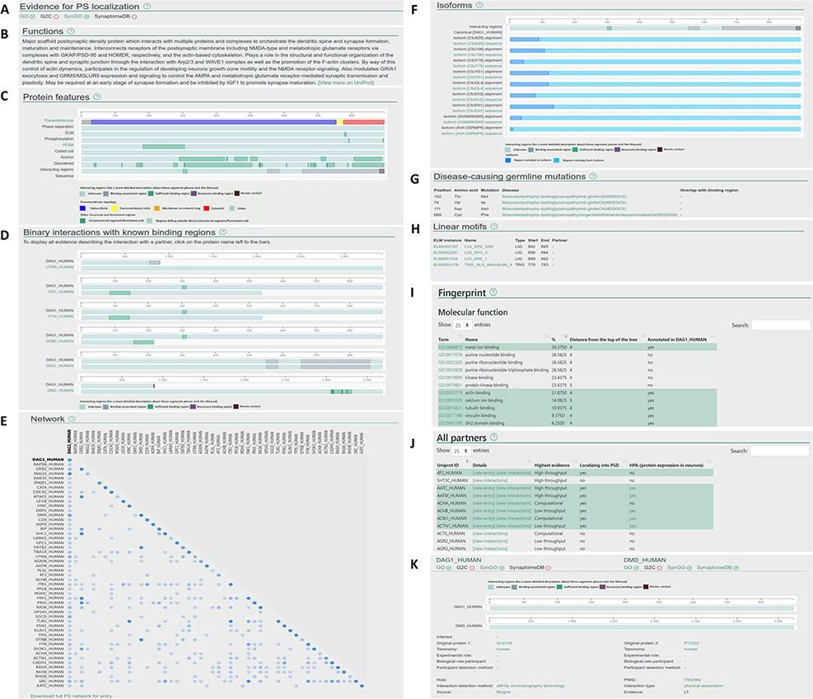
Figure 2. Layout of the individual entry pages (A–J) and the interaction pages (K) of PSINDB: Protein page: (A) ...
Notes:
Figure 2. Layout of the individual entry pages (A–J) and the interaction pages (K) of PSINDB: Protein page: (A) Evidence for PS localization, (B) function, (C) protein features, (D) binary partners with known interacting regions, (E) network, (F) isoforms, (G) disease-causing germline mutations, (H) short linear motifs, (I) fingerprint, (J) all partners. Interaction page: (K) details of the experiment.
Unless provided in the caption above, the following copyright applies to the content of this slide: © The Author(s) 2022. Published by Oxford University Press.This is an Open Access article distributed under the terms of the Creative Commons Attribution License (https://creativecommons.org/licenses/by/4.0/), which permits unrestricted reuse, distribution, and reproduction in any medium, provided the original work is properly cited.

Slide 3
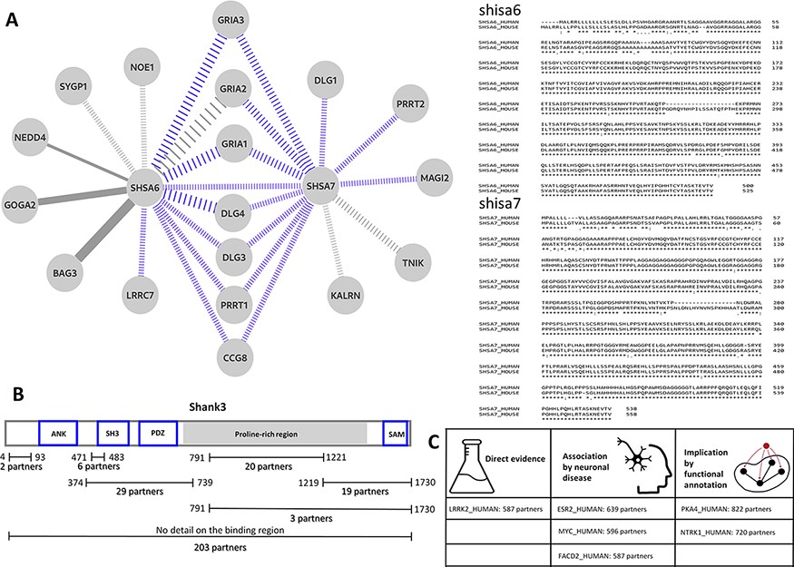
Figure 3. (A) Left: the interaction sub-network of SHSA6 and SHSA7. Edge weights encode the confidence of the ...
Notes:
Figure 3. (A) Left: the interaction sub-network of SHSA6 and SHSA7. Edge weights encode the confidence of the interaction, blue edges show interactions manually curated into PSINDB and dashed lines represent interactions derived from studies on non-human homologues. Right: the alignment between human (top sequences) and mouse (bottom sequences) SHSA proteins. (B) Domain representation of SHANK3, together with the number of partners binding to the different regions of the protein as displayed in the PSINDB database. (C) Proteins not described as part of the PS in any of the source databases. Despite the lack of annotation, they interact with extremely high amounts of PS proteins, and several evidence hint they might localize to the PS or they might have an important role in the PS.
Unless provided in the caption above, the following copyright applies to the content of this slide: © The Author(s) 2022. Published by Oxford University Press.This is an Open Access article distributed under the terms of the Creative Commons Attribution License (https://creativecommons.org/licenses/by/4.0/), which permits unrestricted reuse, distribution, and reproduction in any medium, provided the original work is properly cited.

